Slide 1
Perspectives on Nonpoint Source Bacteria Pollution from a PSD Manager
Presented By Barry Milam

Slide 2
Crab Orchard-MacArthur PSD Territory
The northern service area is located in the Coal River watershed
The southern service are is located in the Guyandotte watershed
The eastern service area is located in the New River watershed.

Slide 3
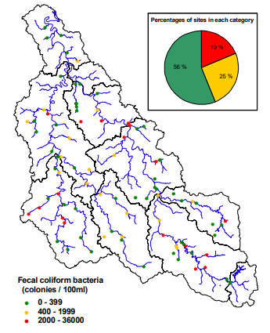
Trap Hill Watershed Association
The very headwaters of the Coal River watershed start in Lester/Glen White area
COMA PSD completed sewer system construction of this area in 2007
The next territory along the headwaters in Marsh Fork
COMA PSD began the design process for the Marsh Fork expansion in the late 2000s

Slide 5
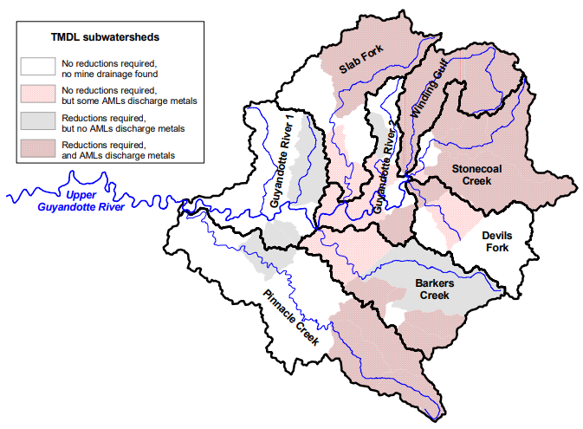
Upper Guyandotte Watershed Association
Worked with Crab Orchard MacArthur PSD to install sewer systems in the communities of Helen and Ury
Received a grant to study the communities of Rhodell and Amigo

Slide 6
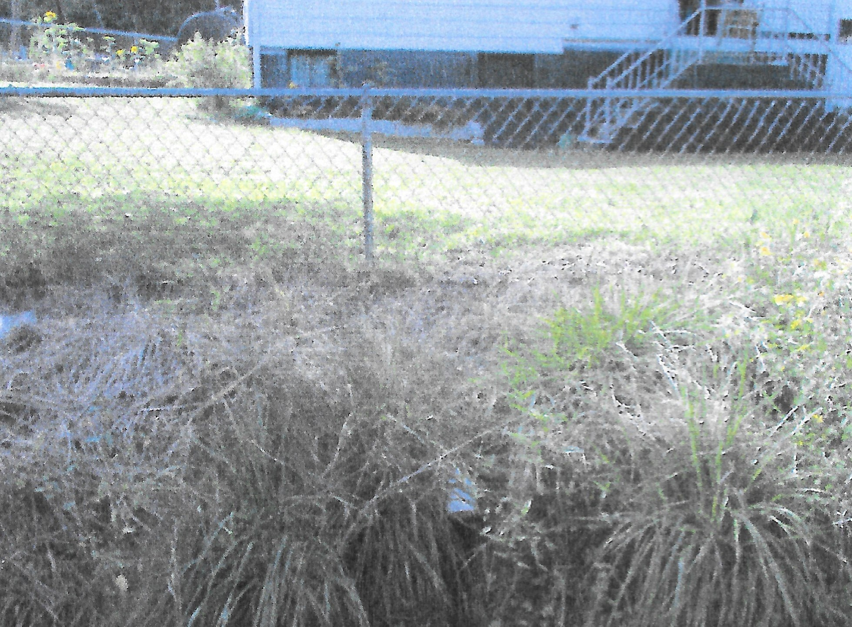
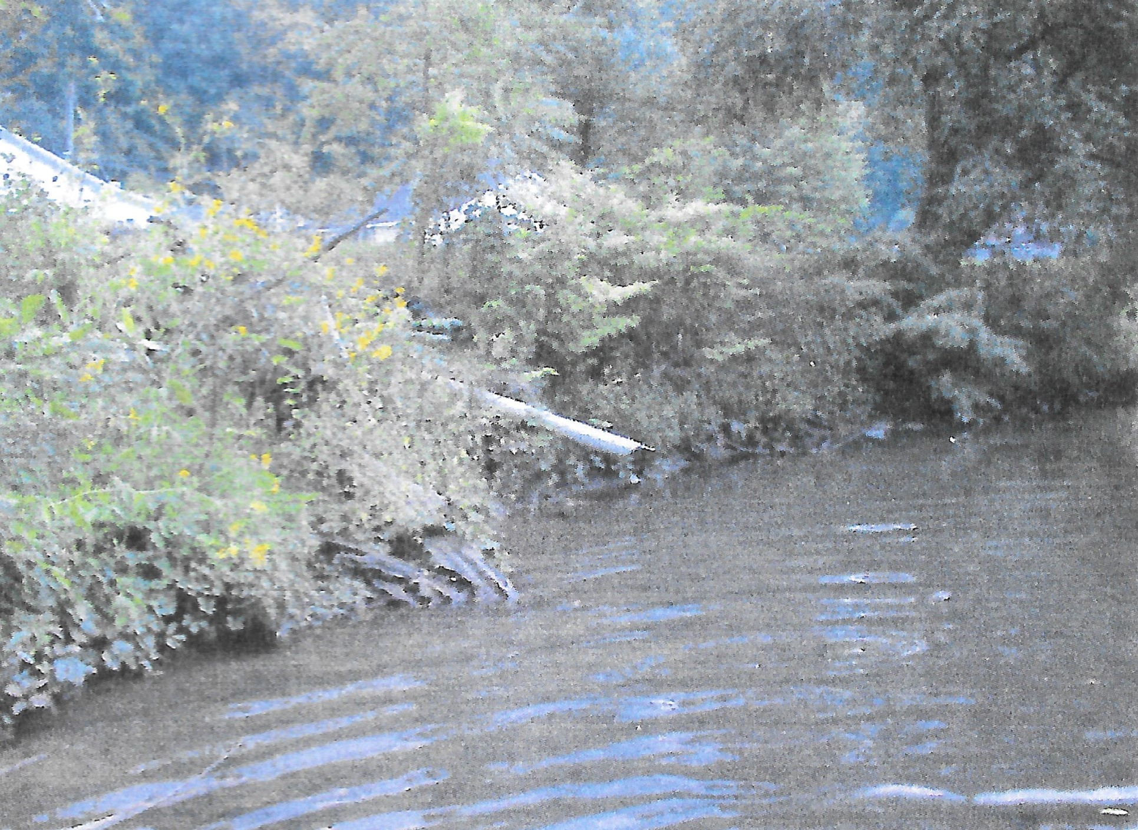
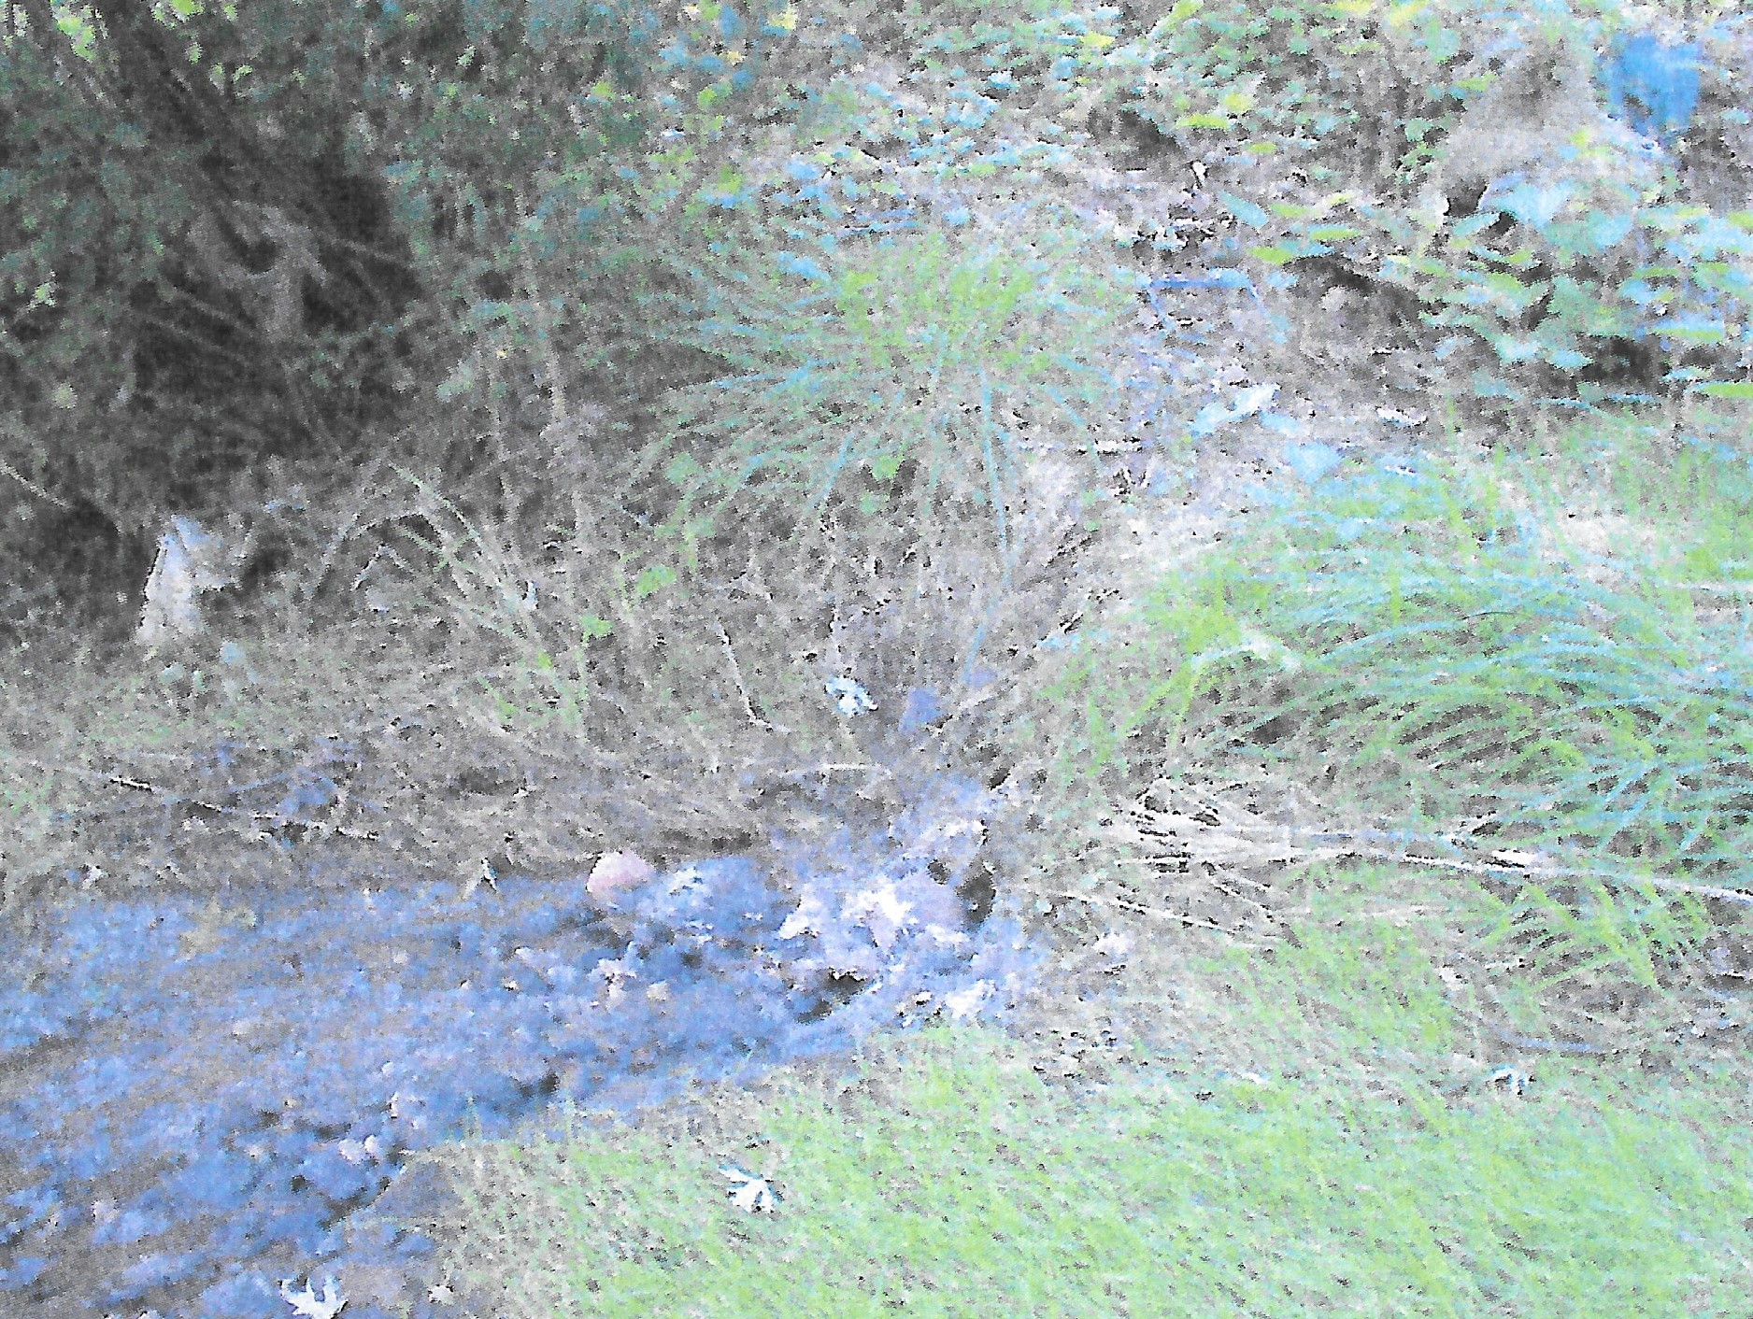
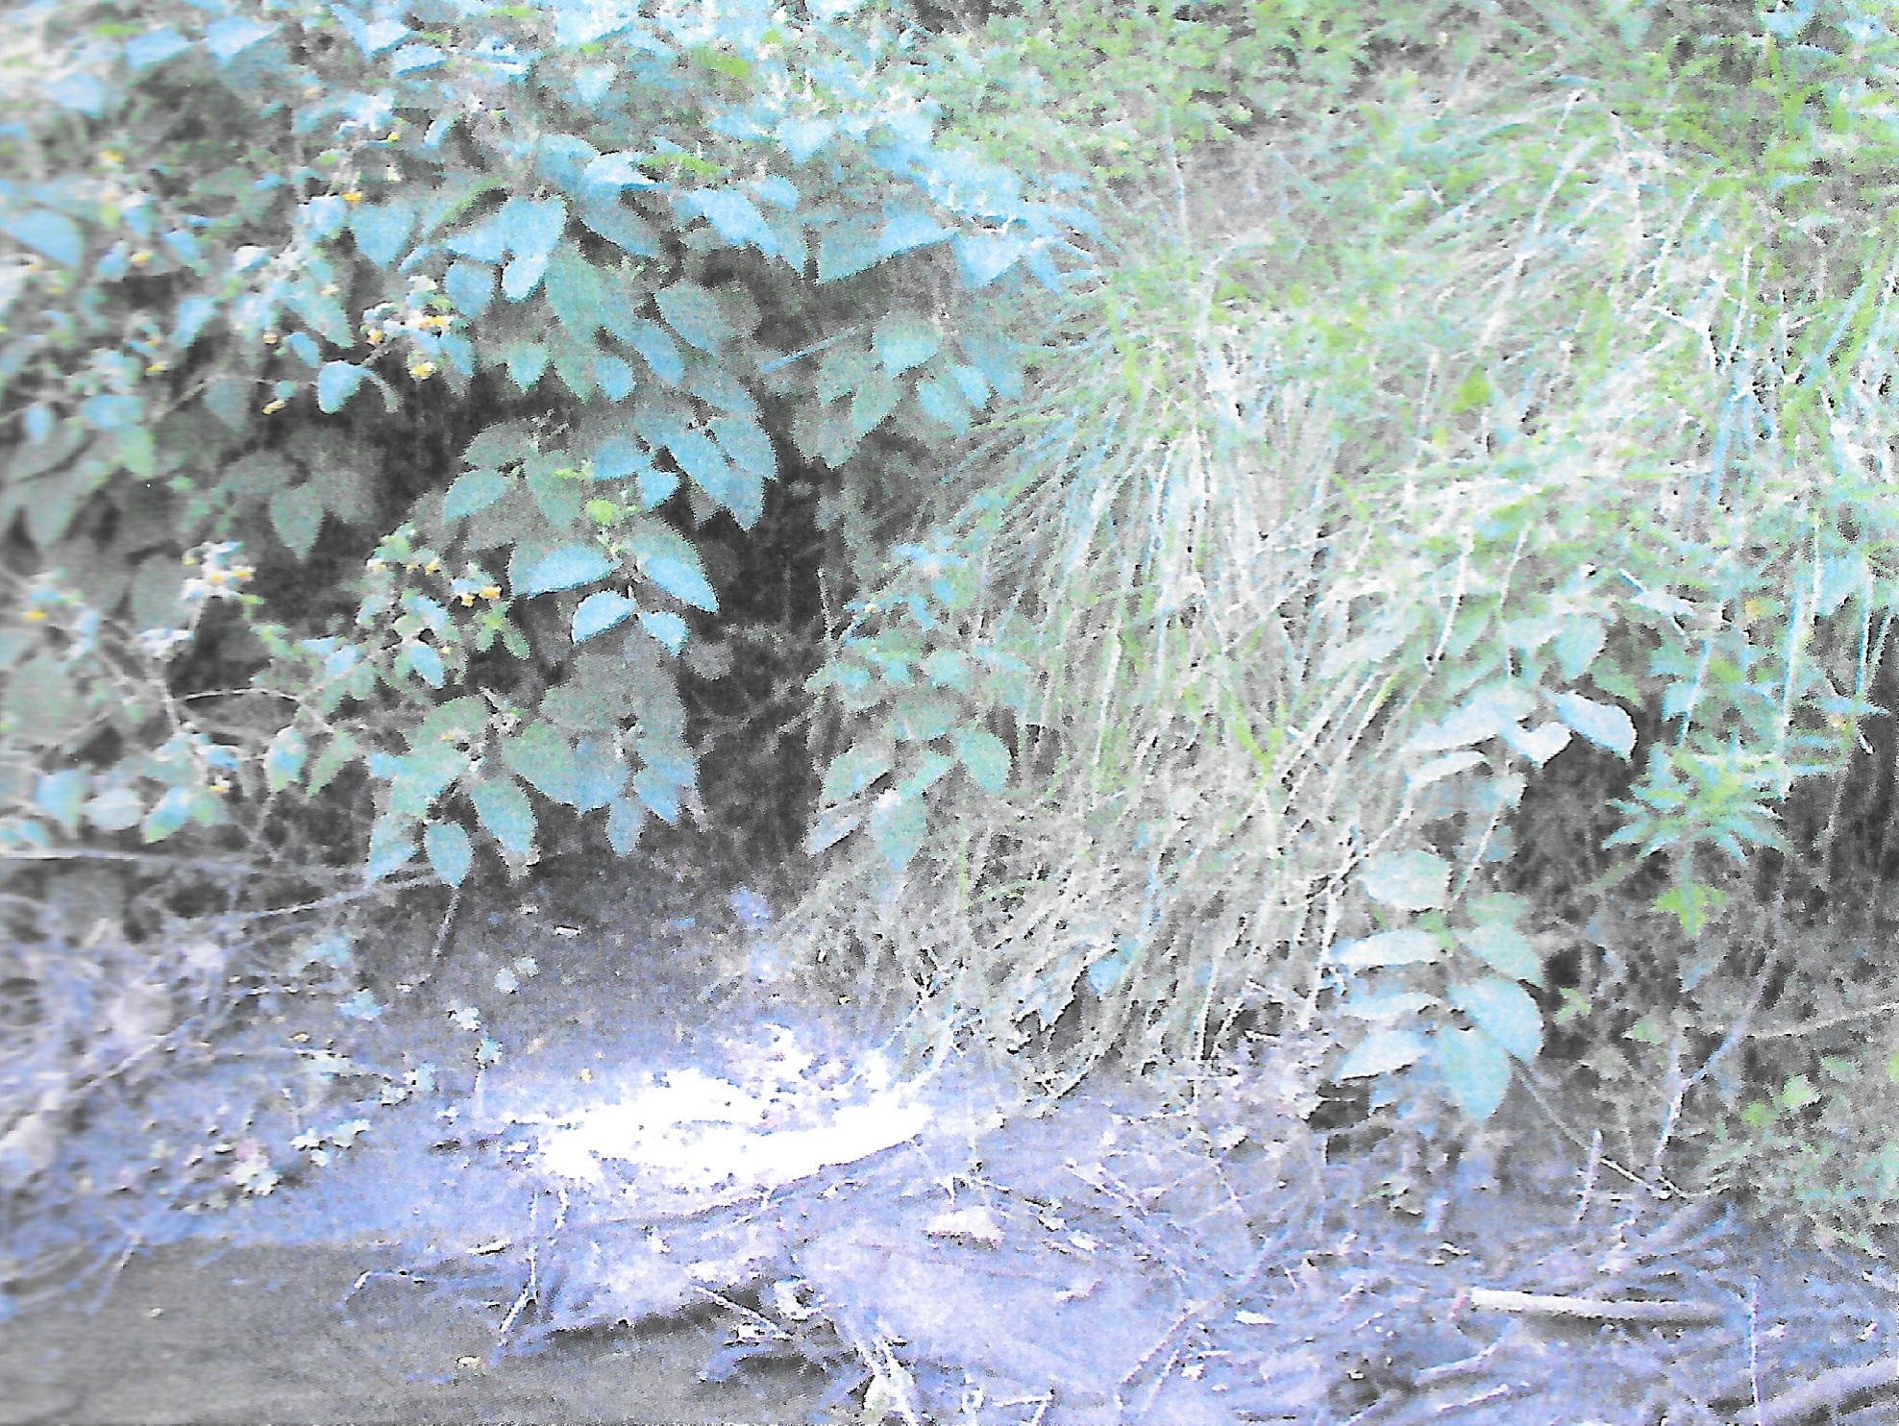
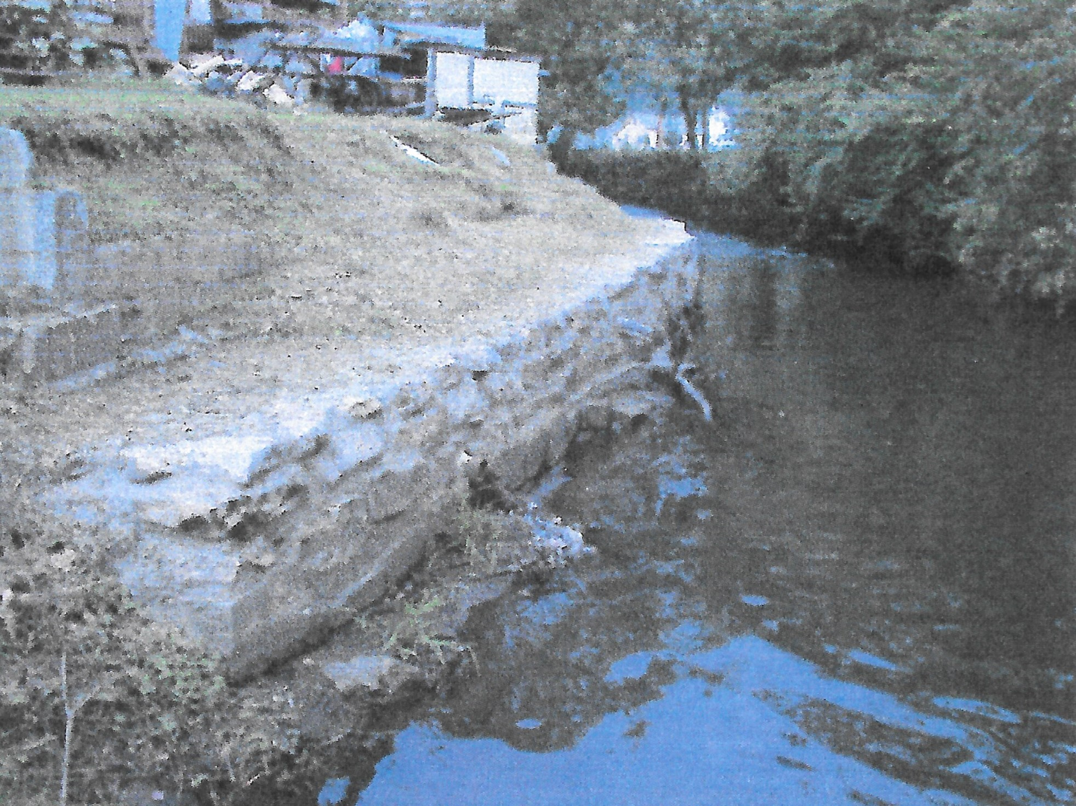
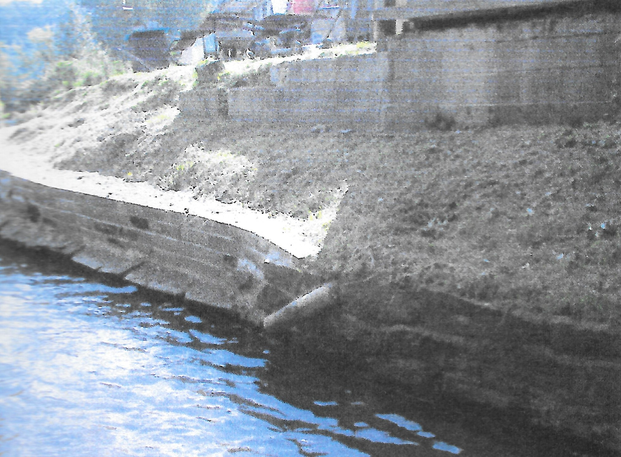

Slide 7
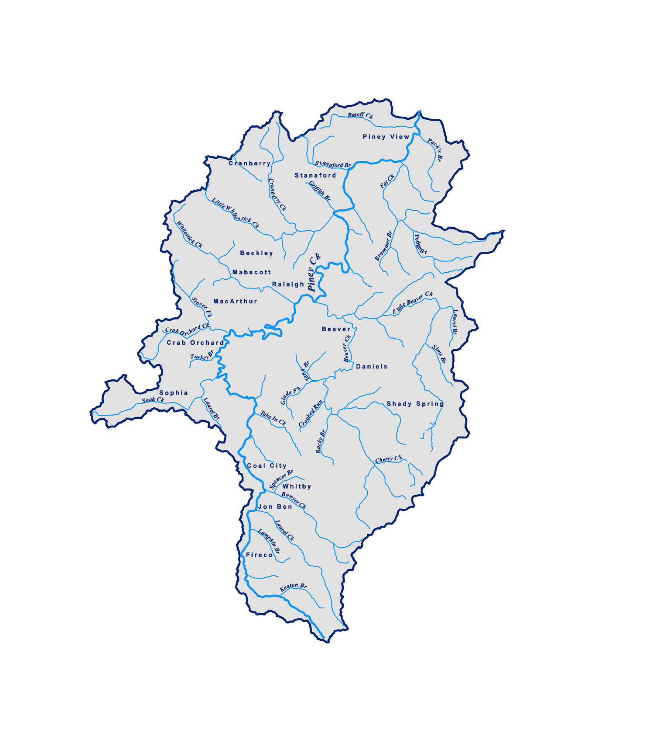
Piney Creek Watershed Association
The Watershed association was founded in 2004
Regular stream monitoring
Working with Beckley Sanitary Board on numerous stormwater projects
Working with the City of Beckley and Raleigh County to develop outdoor recreational trails and parks
Currently working to pump and install septic tanks in the headwater area

Slide 8
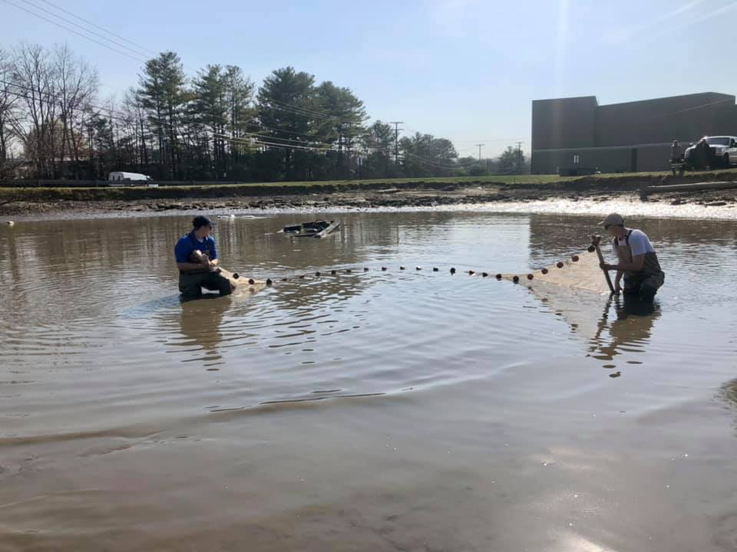
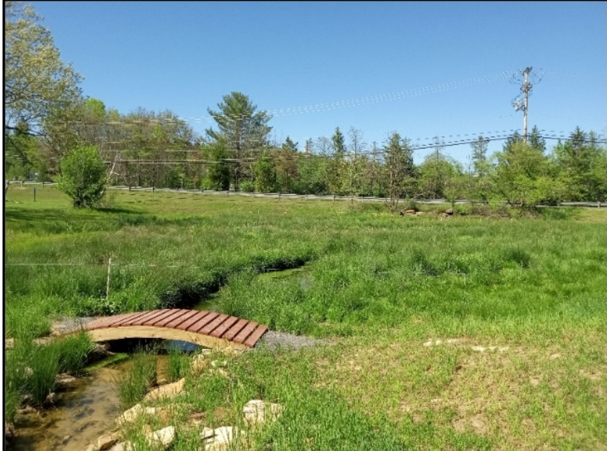
AFTER
BEFORE

Slide 9
Thank You

