Slide 2
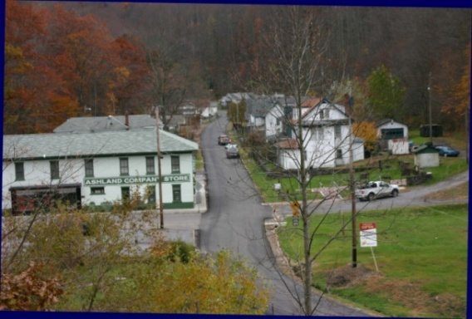
WASTEWATER TREATMENT FOR THE COMMUNITY OF ASHLAND
JENNIFER.D.LIDDLE@WV.GOV 304-574-4465 ext 00294
By Watershed Improvement Branch
Stream Partners Coordinator Jennifer Liddle

Slide 3
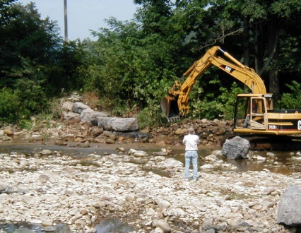
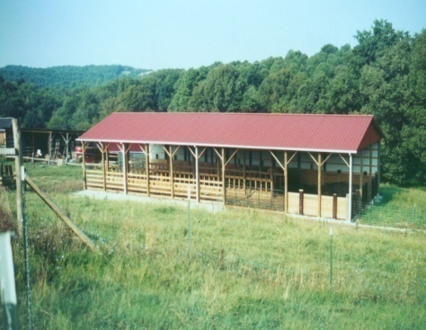
Remember for Project Implementation
Projects are only eligible for Clean Water Act 319 Grant Funds if….
Project is part of a WBP
Project is in a watershed with a TMDL or in a watershed listed on the 303(d) Impaired List with a TMDL scheduled.
Project addresses nonpoint source water quality impairment
Project serves as a demonstration for ‘Best Management Practices’ in a watershed

Slide 4
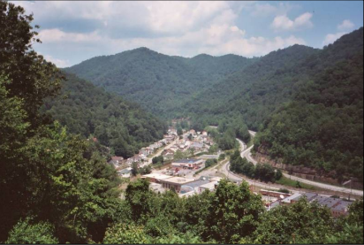
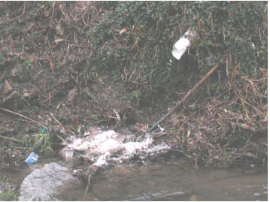
Project example in the Tug Watershed
Challenges in working in this region
Poverty limits residents’ ability to contribute to projects.
Declining population straps communities’ ability to secure and pay back government-sponsored loans and bonds
Topography, soils, weather, and low population density provide hurdles to typical technology and increase the cost solutions
Small, low income communities have limited human resources and citizens are hampered by lack of education and training opportunities and a sense that problems cannot be overcome
Rural communities need a strong voice at state and regional level to provide treatment in rural areas
Article written by CVI in 2011- Highlighting US Rural Infrastructure Need: Wastewater Treatment in Central Appalachian Region

Slide 5
McDowell County Statistics in 2005
Only four towns in McDowell County have wastewater treatment facilities–Welch, War, Bradshaw, and Gary. These four facilities account for 25% of the population.
8% of homes have approved septic systems.
Less than 1% is served by wastewater package plants.
67% of the households in McDowell County lack wastewater treatment.
For those without treatment systems, the wastewater is discharged into the streams.
All streams and rivers in McDowell County are seriously polluted with fecal matter.

Slide 6
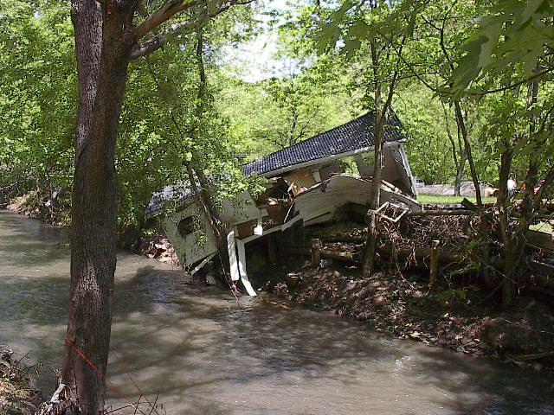
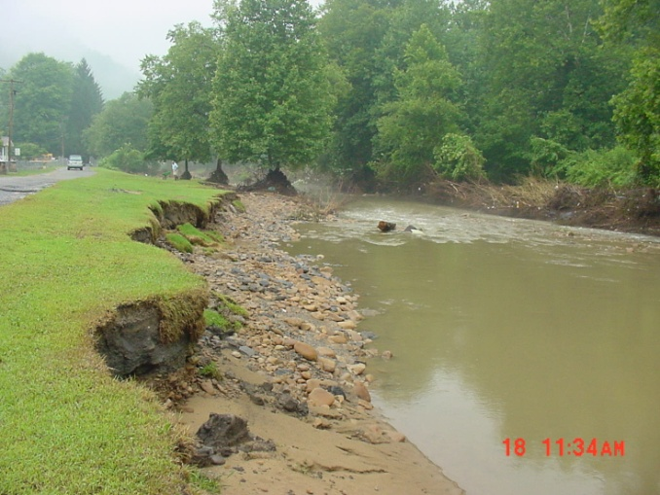
Wastewater Treatment Coalition of McDowell County Timeline
2001-2002 major floods with high damage
2003 Meeting with Rahall resulted in need for comprehensive approach to wastewater needs
2003-4 Installation of demonstration project
2005 Completion of the Countywide Wastewater Plan
2008 EPA Approved Watershed Based Plan of North Fork
2008-9 Implementation of Ashland Wastewater Project
2010 Completion of the Ashland Project and beginning design stages of Crumpler
Notes:
McDowell County was greatly impacted by major 100-year flood events in both 2001 and 2002. These floods affected more than 7,700 homes resulting in $68 million in damages. Non-profit, faith-based, and government organizations responded to the disasters and worked to coordinate assistance through the establishment of the Long-term Flood Recovery Task Force. The Task Force spent two years repairing private and public property damaged by the flooding.

Slide 7
Wastewater Treatment Coalition of McDowell County formed 2003
Members/Partners:
McDowell County Families, Agencies, Children Enhancing Services (F.A.C.E.S)
Mayor of the City of War
The Presbyterian Church’s WV Ministry of Advocacy and Work Camps
McDowell County Economic Development Authority (EDA)
McDowell County Health Department
McDowell County Parks and Recreation
McDowell Rural Health Advisory Council
Residents of Coalwood
Citizens Conservation Corps of WV
Wastewater Operator (Richmorr Associates)
Ashland Community Utilities, Inc.
City of Welch, Project Director
County Commission Representative
SAFE/SHED
McDowell County Redevelopment Authority
Elkhorn Watershed Association
Canaan Valley Institute (CVI)
WVDEP (joined in 2005)
Notes:
The Coalition includes a wide spectrum of local groups, state and Federal agencies, non-profits, faith-based organizations and local residents.

Slide 8
McDowell County Wastewater Treatment Plan
Findings during Wastewater Plan:
67% (or 7,480 homes) have inadequate wastewater treatment
There are 4 existing centralized treatment plants in McDowell running at 33% capacity
Traditional and non-traditional solutions are necessary to serve entire county
Majority of residents are willing to $ for treatment
Wastewater plan had many partners and in-kind contributions exceeding $81,000

Slide 9
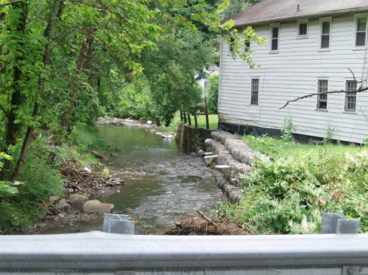
McDowell County Wastewater Treatment Plan
Three main elements:
A detailed assessment of current
wastewater treatment,
A preliminary treatment prescription for all communities without adequate facilities, and
A prioritized list of the 97 project areas identified.

Slide 10
Countywide Wastewater Plan
Sewer Line Extensions. In some areas, extending large sewer lines from existing municipal systems or package plants to outlying communities will be the solution.
Onsite Systems. Some areas will require traditional septic systems, which should also allow for secondary treatment options for individual homes.
Onsite/Cluster Systems. There is a need for a possible combination of individual home treatment systems, which might include clustering several homes together to a shared treatment system.
Package Plants. This is a centralized sewage treatment system for a small community.

Slide 11
Identified Project Areas (1-7)
Project Area/ order | Treatment Strategy | Weighted Score (out of 5) | Pre-requisite | Description
Stringtown (1) | Extension | 4.6 | No | extension of Bradshaw
Ashland (1) | Package Plant | 4.25 | No
Bug Hurley (3) | Extension | 4.25 | Yes | Jolo Extension
Coalwood (1) | Package Plant | 4.25 | No
Jolo Extension (2) | Extension | 4.25 | Yes | Stringtown
Mouth of Bradshaw Mtn. (3) | Extension | 4.25 | Yes | Jolo Extension
Wolf Pen (4) | Extension | 4.25 | Yes | Mouth of Bradshaw Mtn.

Slide 12
Identified Project Areas (8-14)
Project Area/ order | Treatment Strategy | Weighted Score (out of 5) | Pre-requisite | Description
Maitland (1) | Extension | 4.2 | No
Raysal Hollow (2) | Extension | 4.2 | Yes | Raysal
Crumpler (1) | Package Plant | 3.9 | No
North Welch (1) | Extension | 3.9 | No
Atwell South (1) | Onsite | 3.85 | No
Bullcreek (1) | Onsite | 3.85 | No | No public H20
Litwar North (1) | Onsite | 3.85 | No

Slide 13
Map of Treatment by Project

Slide 14
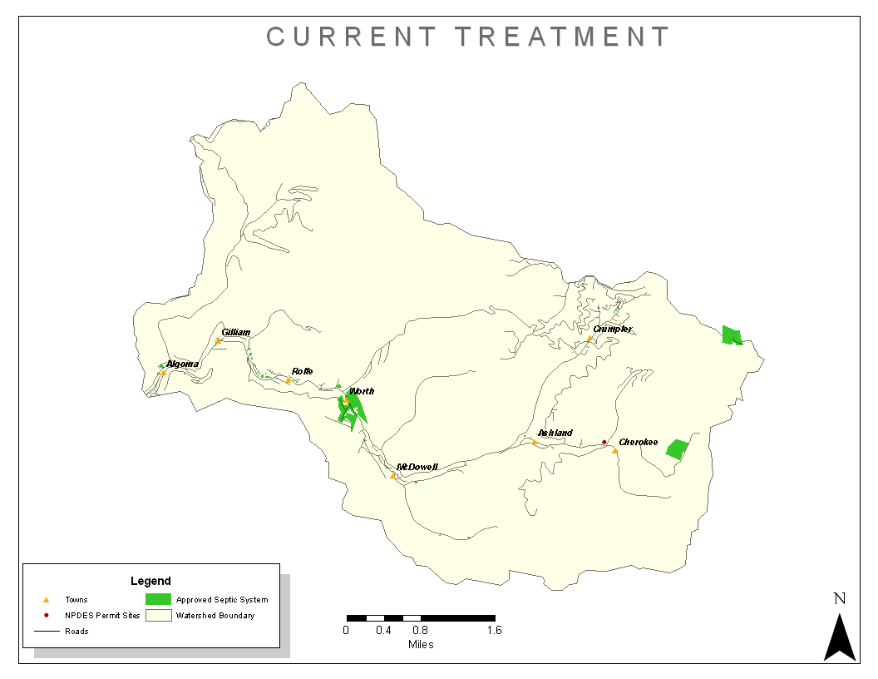

Slide 15
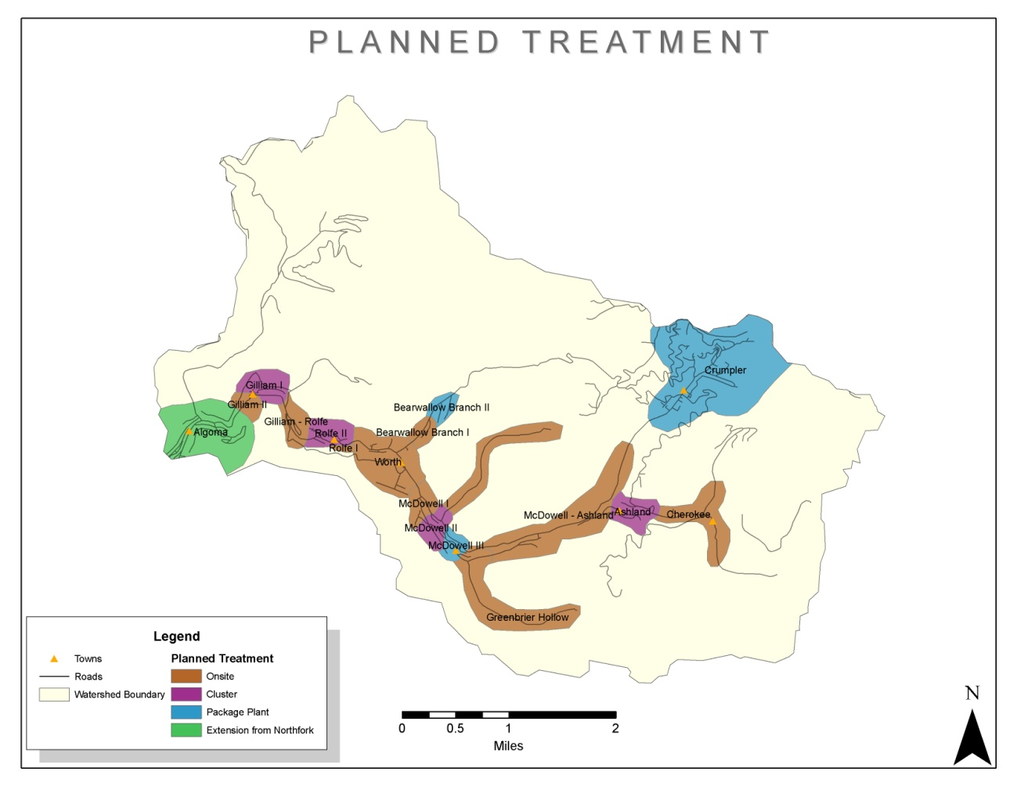

Slide 16
Estimated Fecal Coliform Loads for some communities in NF of Elkhorn
Site | Number of Homes | Estimated Daily Flow (Gal) | Estimated Fecal Load (cfu/year)
 |  |  | Current | Reduction
Algoma | 78 | 13650 | 1.88722E+14 | 1.69849E+14
Gilliam I | 47 | 8225 | 1.13717E+14 | 1.02345E+14
Gilliam II | 10 | 1750 | 2.41951E+13 | 2.39531E+13
Greenbrier Hollow | 14 | 2450 | 3.38731E+13 | 3.35344E+13
McDowell-Ashland | 11 | 1925 | 2.66146E+13 | 2.63484E+13
Ashland | 18 | 3150 | 4.35511E+13 | 3.9196E+13
Cherokee | 12 | 2100 | 2.90341E+13 | 2.87438E+13
Crumpler | 129 | 22575 | 3.12116E+14 | 2.80905E+14
Load = # homes x 2.5 (average persons per home) x avg. waste per person x estimated amt. of fecal coliform x efficiency of proposed treatment

Slide 17
Estimated Project Cost
Site | Number of Homes | Sewer |  | Treatment |  | Total Cost
 |  | Type (Length ft) | Cost | Type | Cost
Algoma | 78 | Gravity (6500) | $673,400 | Connection to Northfolk | $0 | $673,400
Gilliam I | 47 | STEG (1600) | $362,000 | Cluster SF-Drip | $376,000 | $738,000
Gilliam II | 10 | Onsite | $0 | Onsite | $50,000 | $50,000
Greenbrier Hollow | 14 | Onsite | $0 | Onsite | $70,000 | $70,000
McDowell-Ashland | 11 | Onsite | $0 | Onsite | $55,000 | $55,000
Ashland | 18 | STEG (1700) | $272,000 | Cluster-CW-LPP | $160,000 | $432,000
Cherokee | 12 | Onsite | $0 | Onsite | $60,000 | $60,000
Crumpler | 129 | STEP (6000) | $600,000 | Package Plant | $650,160 | $1,250,160

Slide 18
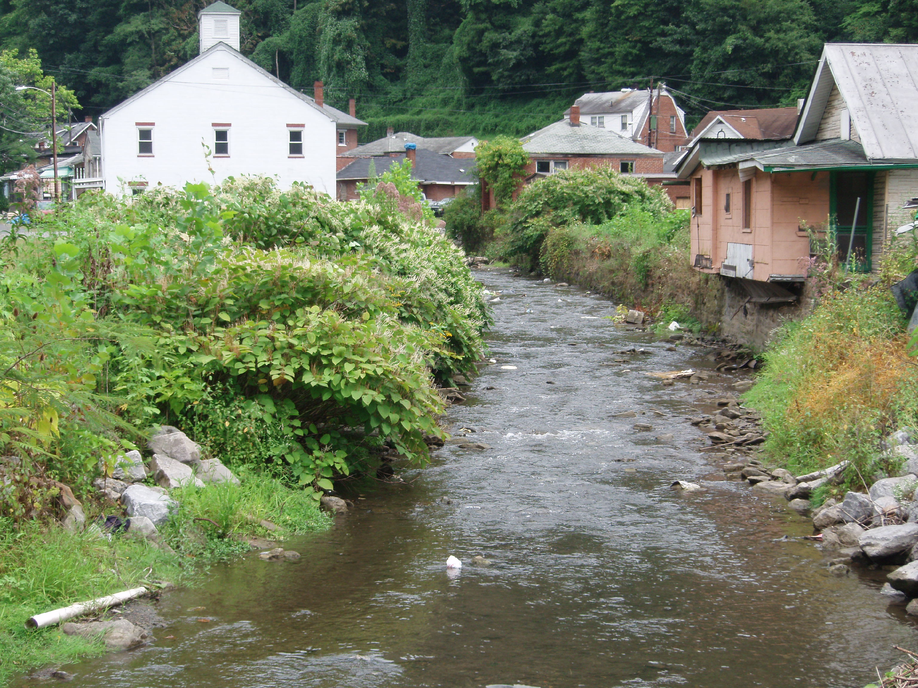
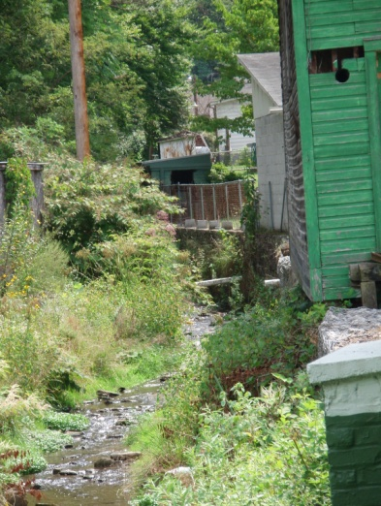
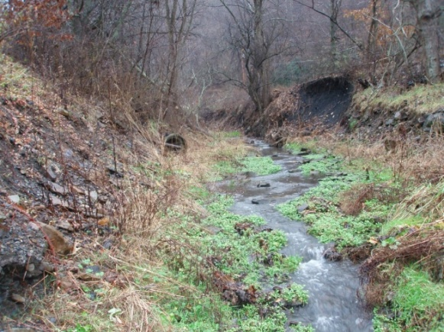
Progress Moving Forward
Ashland is the 1st project identified
Headwaters of Elkhorn Creek
Potentially funding available
through 319
Creation of North Fork of Elkhorn Creek WBP
Identify impacts
Monitor for fecal and metals
Propose project areas for nonpoint
source problems

Slide 19
The Tug Fork Watershed

Slide 20
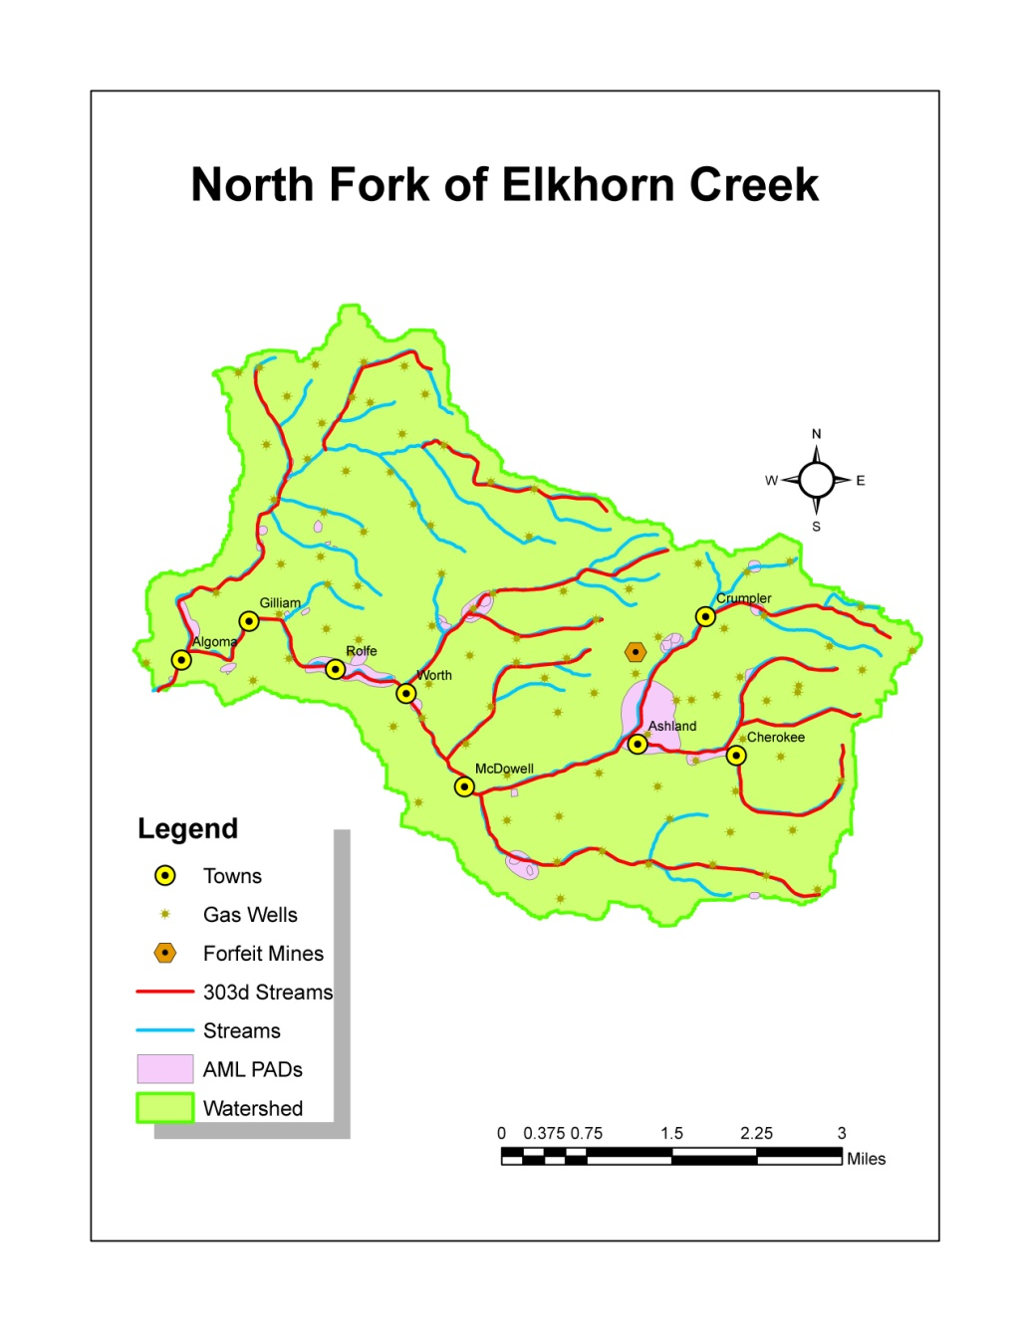
Impairments
303 (d) Listing for North Fork of Elkhorn Creek - Fecal Coliform
Elkhorn Creek – entire length 8 miles
Windmill Gap Branch- entire length 2.8 miles

Slide 21
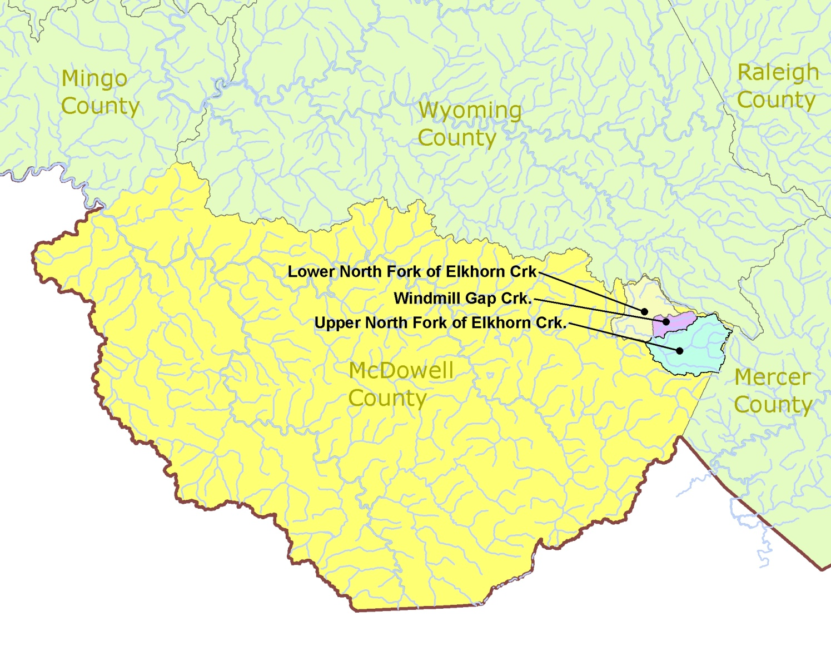
Sub-watersheds (HUC 14) of North Fork of Elkhorn Creek

Slide 22
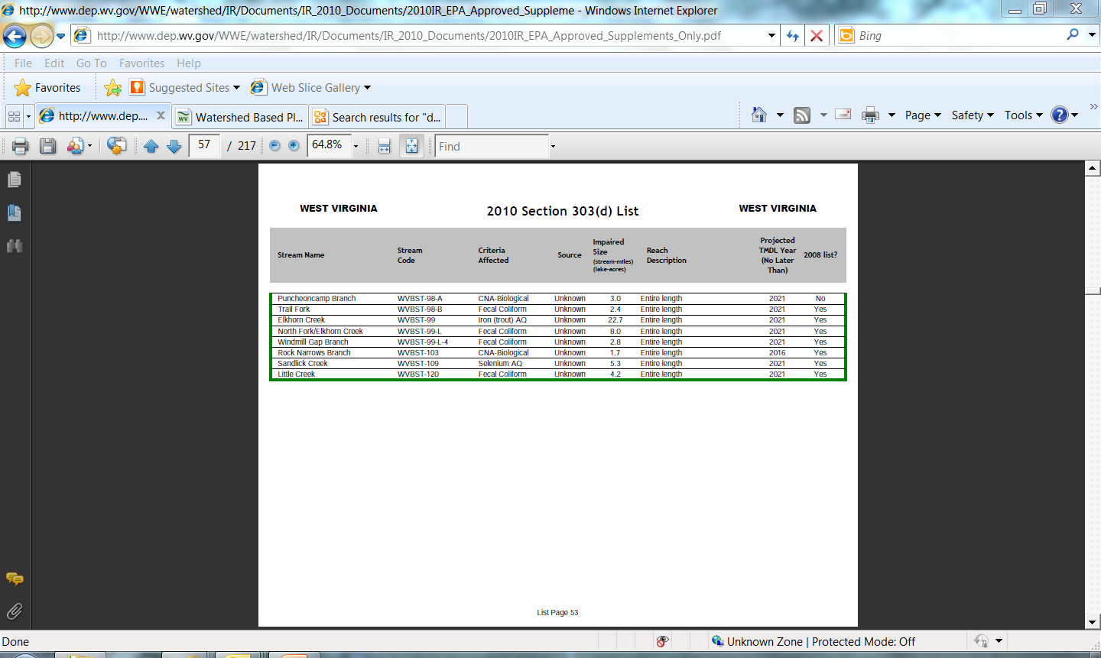
303 (d) List in Tug Watershed

Slide 23
Monitoring Sites for Watershed Based Plan

Slide 24
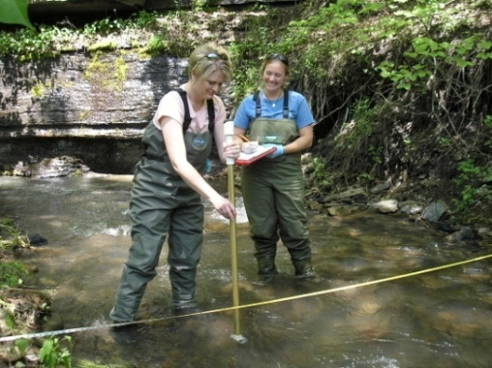
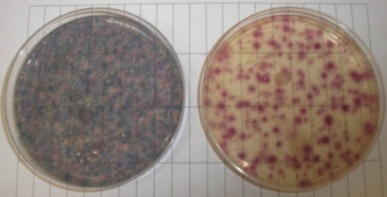
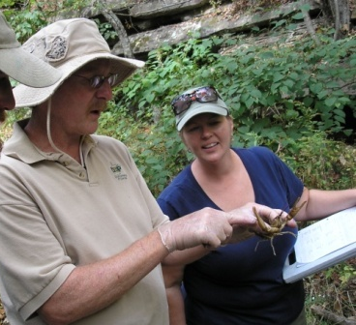
Water Monitoring Data
Water Chemistry
Bugs and Habitat
Parameter | Downstream | Upstream | Unit
Fecal Coliform col/100ml | 200,000 | 54 | col/100ml
Al (dissolved) | 0.0051 | 0.0057 | mg/L
Iron (total) | 0.0772 | 0.1580 | mg/L
Manganese, Total | 0.0134 | 0.0118 | mg/L
Total Suspended Solids | 12 | 15 | mg/L
Parameter | Downstream | Upstream
Habitat Score | 97 - marginal | 155 - suboptimal
Stream Index | 5- marginal | 12- suboptimal

Slide 25
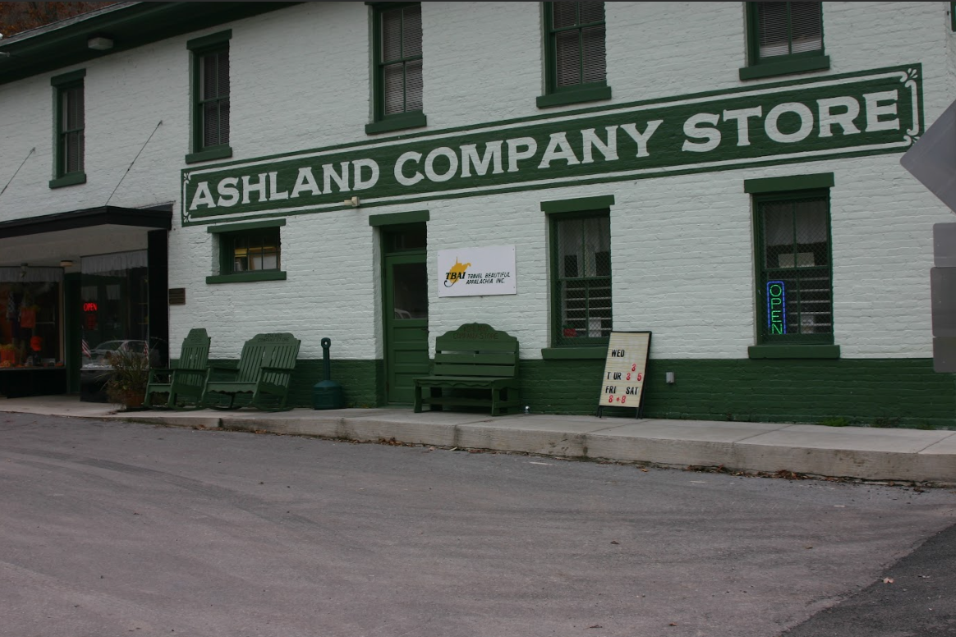
Ashland Wastewater Project
Project Steps:
Identify or form Responsible Management Entity (RME)
Secure funding and hire company to do engineering design work
Secure fiscal agent
Finalized easements & user agreements for homeowner signatures
Developed an informational brochure for distribution to homeowners when signatures are obtained
Negotiated monitoring requirements with DEP’s UIC program
Obtained O&M cost estimates for the treatment system
Finalized estimated monthly rates
Finalized and submitted the watershed based plan
Held an informative meeting with the community
Pursued and obtained additional funding toward the project
Began construction of the drainfields with volunteer labor 2009

Slide 26
Ashland Community Wastewater System Main Components
Wetland Cells-Treatment in the wetland cells is intended to produce secondary quality effluent reducing nutrient (90% reduction) loading in the drainfield.
Low Pressure Pipe Drainfield- Flow is gravity fed from the wetlands cells to 3 siphon tanks to the 3 drainfields.
Windmill Gap Creek
Pump Station and Force Main- The lift station provides detention time for the effluent should both of the pumps be out of service. It also houses 2 pumps that convey the effluent up the hill.
STEG System-Sewage from the houses are collected and transported in a Septic Tank Effluent Gravity (STEG) sewer line running along the underground along the main road to the pump station.
Directional water flow

Slide 27
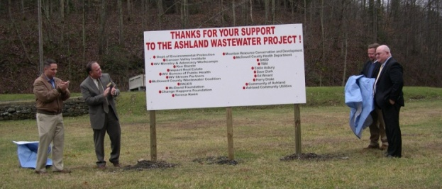
Ashland Wastewater Project
Funding
319 EPA Clean Water Act Funds $ 50,000
DEP Stream Restoration Fund $ 50,000
& $181,650
Private Donation $ 27,036
WV Ministry of Advocacy and Workcamps $ 49,593
Canaan Valley Institute $ 45,265
DEP Funds $ 40,000
McDavid Foundation $ 10,000
Change Happens Foundation/Hawaii $ 10,000
Bureau of Public Health $ 1,125
WV Stream Partners $ 3,000
Cost over $630,000
Groundbreaking Ceremony Spring 2009

Slide 28
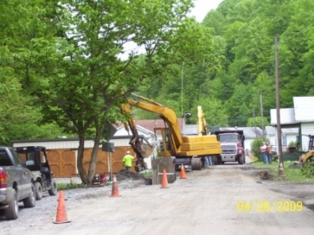
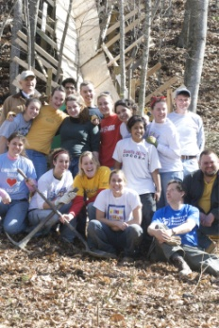
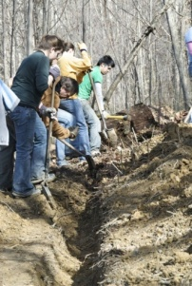
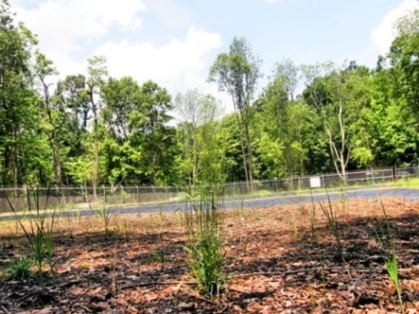
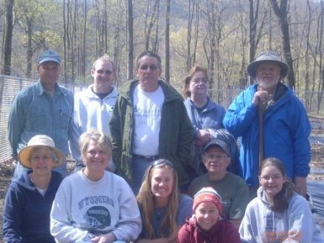
Ashland Wastewater Project
During Construction
Hand dug drainfield
Wetland cells planting

Slide 29
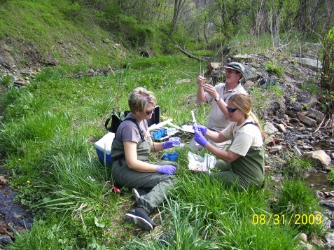
Post Ashland Monitoring
Notes:
The benthic community after only 6 months post construction:
After only six months there is dramatic improvement in the biological community. Overall this section of the stream went from marginal to suboptimal with an increase in diversity and overall score of more than 20%. It is possible that there are other factors influencing these numbers; however the physical characteristics that were observed and recorded tell a similar story. There were no organic odors in the water or sediment; the amount of algae growth was reduced; there was also a significant amount of entrained algae and other organic materials in the sediments that was not evident in the 2010 survey; and finally the composition shifted to slightly more coarse materials. There were no changes in land use.

Slide 30
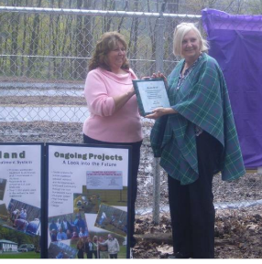
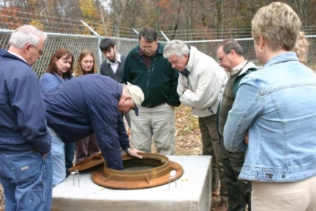
Ashland System Overview
Ashland’s system is a small-diameter sewer, constructed wetland treatment system and community drainfield that treated 22 homes and 2 businesses, removing 3,500 gallons of raw sewage per day, from a headwater tributary to the North Fork.
It served as a demonstration project for decentralized wastewater in McDowell Country and similar sites and also for wastewater management
Ashland is also a good example of community involvement, because all residents signed user agreements and easements to demonstrate the acceptance of the system.
Stafford Consulting out of Princeton is providing engineering oversight, and SHED, Inc is acting as the fiscal agent for the project.
Formed the Ashland Community Utilities company to oversee the sewer project as well as the existing water system.
EPA Site Visit Oct 2009

Slide 31
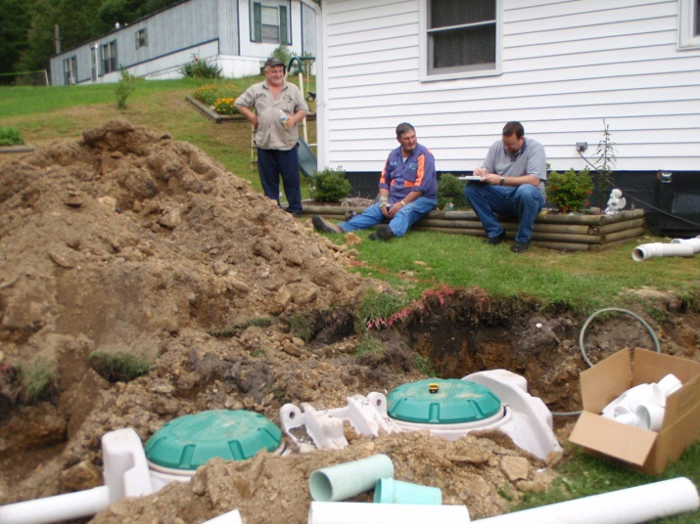
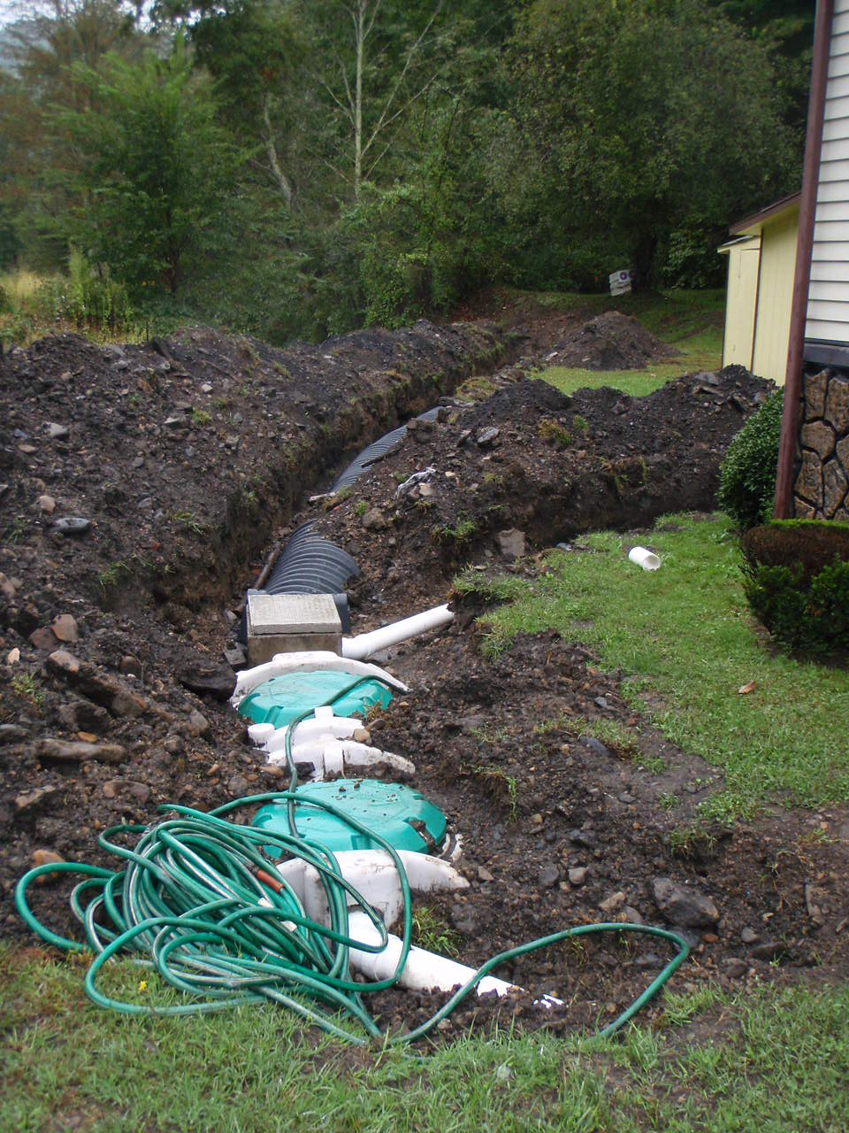
Downstream Communities
Wastewater Treatment Coalition worked on a second 319 grant to help fund individual onsite systems further down the watershed where feasible
Matched with OSLP State Revolving Loan Program
Developed and finalized a brochure on the on-site loan program to provide to homes downstream
Notes:
The Wastewater Trt. Coalition of McDowell County has received several 319 grants went door to door, worked with SHED/SAFE

Slide 32
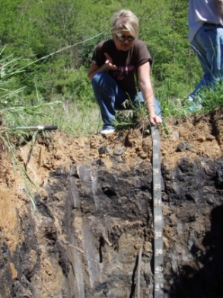
Post Project- Ashland Wastewater
Submitted paperwork to delist Windmill Gap from the 303(d) list
Ashland is a success story on the EPA’s website
Completed preliminary engineering report for Crumpler and has identified possible funding and a design for the community of McDowell
Installed septic systems with OSLP with matching 319 funding in watershed downstream
Continued watershed education and outreach
PSD started showing interest in the wastewater projects in the community

