Slide 1
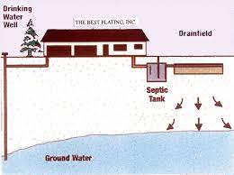
Understanding UIC Septic Systems
Dennis A. Burns, CPESC
West Virginia Department of Environmental Protection

Slide 2
Underground Injection Control
Primacy delegated from EPA
At least as stringent as federal regulations.
Separated into Classes of Wells (1 - 6)
Septic Systems are included in Class 5
State Rules
47CSR13 - The UIC Rule
47CSR9 - UIC Fee Schedule
47CSR55 - Groundwater Act Fee Schedule
Notes:
As with any other program that has primacy it requires regulations that are at least as stringent as the federal rules.
Some of the State regulations for UIC include: 47CSR13 the UIC Rule, 47CSR9 the UIC Fee schedule, and 47CSR55 the groundwater act fee schedule.

Slide 3
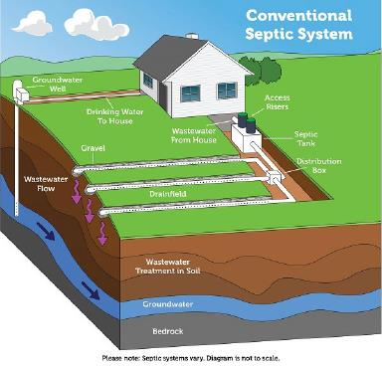
Some Types of Class 5 Wells
Drainage Wells (Stormwater)
Geothermal Reinjection Wells
Domestic Wastewater Disposal Wells - Septic Systems
Mineral and Fossil Fuel Recovery Related Wells
Industrial/Commercial/Utility Disposal Wells
Recharge Wells
Miscellaneous Wells
Banned shallow Class 5 injection wells:
Cesspools - hole in ground for untreated sewage
Motor vehicle waste disposal wells (MVWDW) - floor drain from shop with fuels, oils, coolants, etc. into ground.
Notes:
Class 5 wells can be common activities. Examples include stormwater drainage wells (or sinkholes), septic system leach fields,and industrial disposal wells among others.
EPA has fact sheets for some of these common Class 5 well types as well as other types.
There are a couple of banned class 5 injection wells: Large capacity cesspools - untreated sewage & motor vehicle waste disposal wells - floor drains in auto shops that connect to septic systems or go directly into the ground.
(Potential contaminants for sewage- pathogens, nitrate, phosphorus. Stormwater - TSS/TDS - a little bit of everything it touches.)

Slide 4
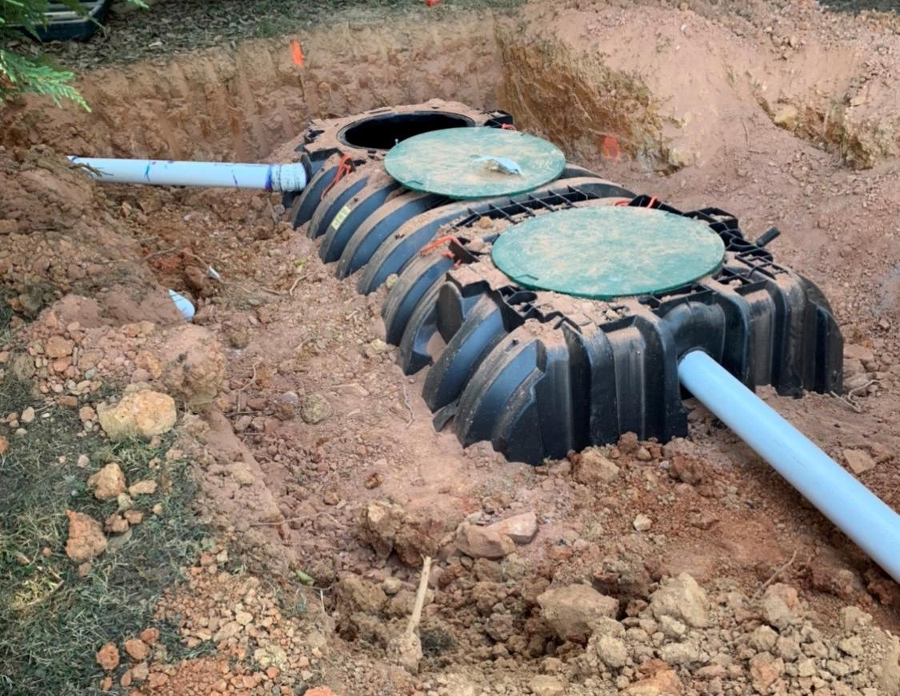
Any Septic System With the Capacity to Handle 20 Individuals or More in a Signal Day Must Have a UIC Septic Permit
Septic Systems are Class 5 UIC Wells per WVDEP and US EPA
This even includes systems that only handle 20 or more people one time a year
This does not include single family residences
Requires a Groundwater Protection Plan
This does not include Home Aeration Units with surface discharge - may be covered with an NPDES General Permit.
Notes:
May include reference to EPA’s description: https://www.epa.gov/uic/large-capacity-septic-systems

Slide 5
Restaurants must include a grease separator with their system. Only bathroom and kitchen waste is allowed to be injected.

Slide 6
Coin Operated Laundromats are not permitted to inject
Notes:
Prohibited via Special Regulations 47 CSR 11 - same as coin-operated/pay to use car washes.

Slide 7
Other Facilities with Waste Streams Other than Sanitary Waste
These facilities may require filters or additional filtration to prevent solids from entering the septic system, a pump and hull tank, and/or a Groundwater Protection Plan

Slide 8
Management Practices Required
Visual Inspections
Sampling
Do not plum storm or roof drains into the system
Provide a barrier to prevent vehicular traffic from the injection point
Do not pave over the injection point
Prevent woody vegetation from growing within 10 feet of the injection point

Slide 9
UIC Permits
Application for the well type.
Application Fee - dependent on volume, type of well, and treatment of injectate.
Monitoring may be required.
Groundwater Protection Plan.
Closure Plan.
Notes:
Permits require: an application for the appropriate well type, an application fee that depends on the type of well, the volume of the injectate, and the treatment of the injectate, a groundwater protection plan, and a closure plan. Some Permits will require monitoring.

