Slide 1
The Science of Managing Fecal Coliform
Dennis A. Burns, CPESC
West Virginia Department of Environmental Protection

Slide 2
Not Your Typical Pollutant
Fecal Coliform is a Living and Breathing Pollutant
It Can Die Off
It Can Reproduce
It Feeds On Carbon
It Produces Waste

Slide 3
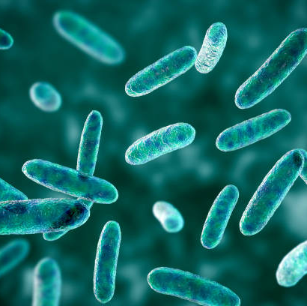
Get to Know Your Enemy
Fecal coliform bacteria is classified in the group proteobacteria and characterized as a chemoheterotrophic proteobacteria. This includes the enteric bacteria, which inhabits the intestinal tract of animals; most enteric are rod-shaped facultative anaerobes; may, such as e.coli, are usually harmless; others are generally pathogenic, including Salmonella, one of the micro-organisms that causes food poisoning. These bacteria absorb their nutrients from the body fluids of living hosts and will use oxygen if it is present but can also grow by fermentation in an anaerobic environment (Campbell, 1996).

Slide 4
Where Does F. Coliform Come From?
USDA-ARS data regarding bacteria production by species/year
Humans | 2.0E+9
Chickens | 2.4E+8
Cow | 5.4E+9 – 2.1E+10
Calf | 1.0E+10
Duck | 1.1E+10
Pig | 8.9E+9
Sheep | 1.8E+10 – 3.7E+10
Lamb | 1.5E+10
Turkey | 1.3E+8

Slide 5
Where Does F. Coliform Come From?
Soil – Soil samples collected for TMDL development has indicated that soils can contain fecal coliform. Average 50 counts per gram
Potential Geological Sources – Research currently being conducted at the University of Tennessee on subsurface microbes, many of which are unknown bacteria that may cause false positives for fecal coliform.

Slide 6
How Does F. Coliform Move Through Soil?
Facts: (G.C. Pasquarell and D.G. Boyer 1994) Fecal coliform transport through soils are affected by several factors. Presence or absence of livestock, the amount of soil water available to transport fecal bacteria to the conduit waters, the storage of fecal bacteria in the soil zone, and the rate of bacterial die off in percolation and conduit waters. It has been shown that fecal bacteria have rapid die-off rates in natural waters, with a half-life on the order of 1 day or less. On the other hand, microorganism that remain in the soil aerobic zone may survive for prolonged periods of time perhaps on the order of several months. Some die-off is expected to occur in transit through the subcutaneous zone, lowering its fecal coliform concentrations. During dry periods, little or no bacteria will be transported. In soil zones where conductivity values were lower, a more effective transport mechanism was provided for bacterial contamination.
Thus:
Buffers installed on land where livestock had previously grazed will not demonstrate load reductions immediately following the instillation of the project.
Buffers that will take on overland flow of water should be designed for retention of stormwater for at least 24 hours in order to achieve load reductions.
Practices such as streambank stabilization and natural stream restoration can address fecal load reductions by preventing sediment attached bacteria from entering the water way.
Practices that increase soil conductivity can aid in fecal load reductions by preventing transport mechanisms

Slide 7
How is F. Coliform Transported?
Fact: (D.G. Boyer and E. Kuczynska, 2003) In a study comparing storm and seasonal distributions of fecal coliform and cryptosporidium in a spring; fecal coliform densities did not correlate positively with Cryptosporidium oocyst densities. Fecal coliform densities were greatest at storm peaks, when sediment loads were also greatest. Thus Multiple transport mechanisms may necessitate various agricultural land management and livestock health maintenance practices to control movement of pathogens to karst groundwater.
Thus:
Fecal coliform is extremely prone to attach itself to soil particles and sediment. This furthers the argument that erosion prevention on agricultural land may play a key role in reducing fecal coliform in streams.

Slide 8
How is F. Coliform Transported?
Fact: (D.G. Boyer 2008) Peak fecal bacteria concentrations have been shown to coincide with peak flow and peak sediment load in karst springs indicating that soil attachment is an important mode of transport. In this study, a reduction of 85% to 96% of fecal coliform concentrations in sinkholes located in pasture land was shown to be an effective practice for reducing fecal coliforms. Pesticides and phosphorus are known to be transported with soil particles as sorbed chemicals.
Thus:
The percentage of fecal reduction should coordinate 85% to 96% of the percentage of soil saved utilizing the revised universal soil loss equation
Sinkhole filters would be an appropriate practice to reduce fecal loads from pastureland at a rate of 85% to 95%

Slide 9
How Should A Program to Manage F. Coliform Be Operated?
Fact: (Boyer, 2005) A study was conducted evaluating water quality improvement program effectiveness for carbonate aquifers in grazed land watersheds. Practices addressed included nutrient management plans, animal watering systems, rotational grazing, crop scouting, manure containment systems, animal exclusions, streambank protection, and sinkhole protection. The study concluded that while some reductions of fecal coliform were seen, most of them were not statistically significant. The one site that did show a statistically significant reduction was due to a change in management and fencing near the spring. Thus, in or order for water quality improvement programs to have sustainable positive impacts at the watershed scale, it might be necessary to target specific sites rather than relying solely on voluntary cost sharing efforts.
Thus:
In order for programs addressing fecal coliform on agricultural land to be effective, they should be targeted to specific sub-watersheds and based on a practice by practice situation for determining if a load reduction will occur.

Slide 10
What Practices are Effective to Address F. Coliform?
Fact: (D.G. Boyer and G.C. Pasquarell, 1999) A study was conducted comparing two dairy operations. One operation had no BMP’s to control fecal contamination, the other operation consisted of a waste storage facility to address fecal contaminated runoff. Evaluation of sampling data from this study indicated that there was a 99% difference between the fecal counts associated with the two operations. The dairy with the waste storage facility contributed the less. Additionally, samples for this study were also taken along pasture land with no BMP’s to control animal waste. The study concluded that BMP’s such as rotational grazing, divisional fencing, animal exclusion from sinkholes, and water distribution systems for livestock are adequate for reducing fecal coliform densities. A waste management system with such practices as roofing and curbing of the loafing pad, a waste storage structure, and a manure and nutrient management plan can reduce the potential for affecting water quality.
Thus:
Until other data is presented, it can be assumed that waste storage facilities and waste management systems will reduce fecal load by 99%. Additionally, pasture systems that reduce livestock access to streams and increase grazing times could constitute similar results.

Slide 11
How Should a Buffer be Designed to Address F. Coliform?
Fact: (Sullivan, Moore, Thomas, Millery, Snyder, Wustenburg, Wustenburg, Mickey, and Moore, 2007) In a study designed to determine the efficiency of vegetated buffers in preventing transport of fecal coliform bacteria from pasturelands, it was found that the presence of a vegetated buffer of any size from 1 to 25 m, generally reduced the median FCB concentration in runoff by more than 99%. The results also suggest that where substantial FCB contamination of runoff occurs from manure-treated pasturelands, it might be disproportionately associated with specific field or management conditions, such as the presence of soils that exhibit low water infiltration and generate large volumes of runoff or the absence of a vegetated buffer.
Thus:
Vegetative buffers of 1-3 m implemented in normal situations without the presence of irrigation systems or typically saturated soils are capable of reducing fecal loading by 99%.
In situations where irrigation is present and/or soils have a tendency to saturate, wider buffers should be planned for more than 10 m.
These findings correspond with(G.C. Pasquarell and D.G. Boyer 1994) in that the bacteria is more likely to move in wet soils or with the presence of overland flow.

Slide 12
Other Things to Consider When Sizing a Buffer: Predicted Pollutant Removal Efficiency %
 |  | Buffer Width
Pollutant | Buffer type | 5m (16 ft) | 10m (33 ft) | 20m (66 ft) | 30m (98ft)
Sediment & Bacteria | Slope = 5% mixed grass and trees | 67 | 76 | 78 | 78
 | Slope = 5% grass/trees only | 82 | 91 | 93 | 93
 | Slope = 10% mixed grass and Trees | 77 | 86 | 88 | 88
 | Slope = 10% grass/trees only | 92 | 100 | 100 | 100
 | Slope = 15% mixed grass and trees | 58 | 67 | 68 | 68
 | Slope = 15% grass/trees only | 73 | 81 | 83 | 83
Nitrogen | Mixed grass and trees/grass only | 49 | 71 | 91 | 98
 | Trees only | 63 | 85 | 100 | 100
Phosphorus | Mixed grass and trees/grass only | 51 | 69 | 97 | 100
 | Trees only | 80 | 98 | 100 | 100
Pesticide |  | 62 | 83 | 92 | 93
Source: Xuyang Zhang, Xingmei Liu, Minghua Zhang, Melissa Eitzel, and Randy A. Dahlgren. 2010. A Review of Vegetated Buffers and a Meta-analysis of their Mitigation Efficacy in reducing Nonpoint Source Pollution. Journal of Environmental Quality 39:76-84 (2010)

Slide 13
Riparian Vegetation for Stabilization
Use Deep Rooted Vegetation When Possible
Trees & Shrubs
Willows
Cottonwood
Water Birch
Alder
Silky Dogwood
Ironwood
Grasses
Cool Season
Annual Rye
Fescue
Reed Canary Grass
Warm Season
Millet
Gama Grass
Switchgrass
Indiangrass
And Anything Else You See Growing on Site Naturally
Notes:
When selecting plants for a bank stabilization site, keep in mind what the plants are going to do for the site and the limitations posed by the site. Not every plant is good for every site. Also consider the time of year the plants will be established, the method of planting, and availability of plant materials.

Slide 14
Root Depth of Common Grasses
Big Blue Stem | 9 ft
Indian Grass | 8
Kentucky Bluegrass | 1
Side Oats Gama | 7
Switch Grass | 10
Little Blue Stem | 5
Annual Rye Grass | 4.25
Fescue | 4
Orchard grass | 4
Deep Roots Provide Stabilization and Capacity
Notes:
Grasses are excellent for establishing ground cover to prevent splash and sheet erosion, but do little to hold against concentrated water flow and mass soil erosion. Nevertheless, they are essential for the whole system to function properly. Consider both deep rooted and shallow rooted grasses. Commonly the cool season grasses are quicker to establish but have shallow roots. The warm season grasses have deeper roots but are slower to establish. When determining how deep grass roots are needed it is important to consider soil type for supporting such species.

Slide 15
Active Growing Vegetation throughout the Season is Important for Capturing Flow
Typical Growth Patterns of Common Grasses and Legumes
Notes:
This chart indicates the growth patterns of various grass and legume species. In order for the riparian erosion control system to function properly, both warm season and cool season grasses should be established to assure optimum herbaceous growth throughout the entire growing season.

Slide 16
Tensile Strength of Common Trees
Silver Maple | 15-30 MPa
Alder | 32-52 MPa
Spruce | 16-28 MPa
Pines | 10-33 MPa
Poplars | 5-38 MPa
Oak | 20 MPa
Willows | 18-37 MPa
 | (1 MPa = 145 Pounds per Square Inch)
Strong Roots Prevent the Buffer from Eroding and Releasing Bacteria into the Receiving Stream
Notes:
Trees are used for root systems that will hold soil in place. Consider the overall impact of the tree. For example, if a shrubby willow tree will hold the soil tighter than an oak tree, one should give more consideration to the willow; but if there are no willows and the oak is growing naturally, consider the oak. Also consider the mass of the tree. Ask yourself, is the stream bank stable enough to hold the weight of and oak tree, or is the willow more suited to prevent less stress on the riparian system.

Slide 17
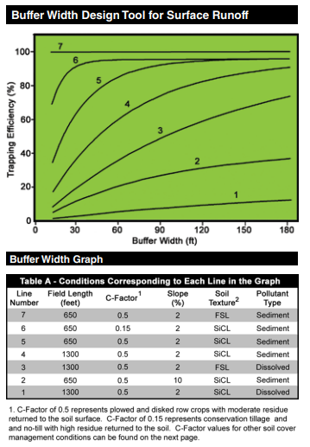
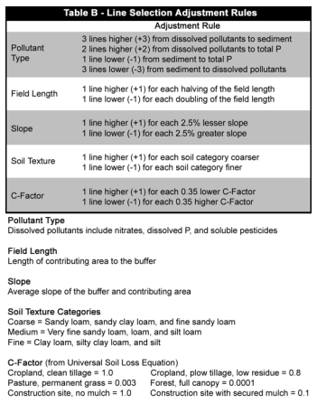
Source: U.S. Forest Service Buffer Planning Tool

Slide 18
Boyer DG. AGRICULTURAL LAND USE IMPACTS ON BACTERIAL WATER ally mediated activity breaks down organic in karst groundwater resurging to the surface in the Appalachian Region resides on karst management of the Appalachian Region ' s land. Journal Of The American Water Resources Association. 1999;35(2):291-300.
Boyer DG, Kuczynska E. STORM AND SEASONAL DISTRIBUTIONS OF FECAL COLIFORMS AND CRYPTOSPORIDIUM IN A SPRING 1. 2004;25813:1449-1456.
Boyer DG. WATER QUALITY IMPROVEMENT PROGRAM EFFECTIVENESS FOR CARBONATE AQUIFERS IN GRAZED LAND WATERSHEDS 1. October. 2005;25813(04018):291-300.
Boyer DG. AGRICULTURAL LAND USE IMPACTS ON BACTERIAL WATER ally mediated activity breaks down organic in karst groundwater resurging to the surface in the Appalachian Region resides on karst management of the Appalachian Region ' s land. Journal Of The American Water Resources Association. 1999;35(2):291-300.
Sullivan TJ, Moore ÆJ, Thomas ÆD, et al. Efficacy of Vegetated Buffers in Preventing Transport of Fecal Coliform Bacteria from Pasturelands. Journal of Environmental Quality. 2007:958-965.
Source: Xuyang Zhang, Xingmei Liu, Minghua Zhang, Melissa Eitzel, and Randy A. Dahlgren. 2010. A Review of Vegetated Buffers and a Meta-analysis of their Mitigation Efficacy in reducing Nonpoint Source Pollution. Journal of Environmental Quality 39:76-84 (2010)

