Slide 1
Welcome from West Virginia Rivers Coalition!

Slide 2
Agenda & Housekeeping
Agenda for Today:
Housekeeping:
Welcome & Introductions
Presentations
Jenna Dodson, WV Rivers Coalition
Dr. Alan Ducatman, WVU
Delegate Evan Hansen, WV House of Delegates & Downstream Strategies
Scott Mandirola, WVDEP
Questions & Answers
Please keep yourself muted during the presentations, until we open the floor for questions.
We ask that you hold all questions until the end so our presenters may answer collaboratively.
You may place your questions into the chat during the presentation, or raise your hand at the start of the Q&A.

Slide 3
Jenna Dodson Staff Scientist West Virginia Rivers Coalition
Notes:
Our first speaker is Jenna Dodson.
Jenna is the staff scientist at West Virginia Rivers Coalition. She has international experience as an academic researcher and extension agent, and enjoys bridging the gaps between science, policy, and the public.

Slide 4
What are PFAS and how do they get into drinking water?
Per- and poly-fluoroalkyl substances (PFAS) - group of man-made chemicals
10,000-12,000 types of PFAS
“Forever chemicals” that don’t break down in the environment
Used in manufacturing since the 1950s for non-stick, stain resistant, water resistant properties
Examples of products with PFAS:
Non-stick cookware
Firefighting foam
Carpet
Food packaging
Notes:
What makes a PFAS a PFAS? PFAS molecules have a chain of linked carbon and fluorine atoms. Because the carbon-fluorine bond is one of the strongest, these chemicals do not degrade easily in the environment, and are considered “forever chemicals”
There are around 10,000-12,000 types of PFAS, about 600 used in the United States
Their non-stick, waterproof, and stain resistant properties are favorable for use in nearly all industries, and most consumer products
Graphic from: https://www.researchgate.net/figure/Chemical-structure-of-perfluorooctanoic-acid-PFOA_fig1_328674109
Major sources of PFAS contamination include industrial manufacturing facilities, wastewater treatment plants, landfills, biosolids (sewage sludge), military bases, and airports
PFAS from these sources can contaminate waterbodies through direct discharge, runoff, and/or air deposition
Many industrial manufacturing facilities discharge wastewater with detectable levels of PFAS into rivers or streams
Groundwater is also susceptible to PFAS contamination, particularly from the usage of fire-fighting foam at military bases and airports
Here in West Virginia, industrial facilities, military installations, and airports are known sources of contamination:
Chemours manufacturing plant in Parkersburg (severely contaminated in drinking water 40 years ago, and continues to discharge PFAS into the Ohio River)
Shepherd Field Air National Guard base in Martinsburg (fire-fighting foam migrated through the groundwater and contaminated the community water supply)
Additional reports of groundwater contamination from military activities at the Yeager Airport in Charleston
Graphic from: https://ncpfastnetwork.com/printed-materials/

Slide 5
EPA’s Draft Drinking Water Standards (MCLs)
PFOS: 4 ppt
PFOA: 4 ppt
GenX, PFBS, PFNA, PFHxS: Hazard Index = 1.0
Hazard Index = ($\frac{GenX }{10 ppt}$ ) + ($\frac{PFBS }{2000 ppt}$) + ($\frac{PFNA }{10 ppt}$ ) + ($\frac{PFHxS }{9 ppt}$)
Notes:
PFAS are known toxins that cause adverse health issues at very low levels
Graphic from: https://www.michigan.gov/-/media/Project/Websites/PFAS-Response/Images/PPT-Swimming-Pool.pdf?rev=5104c6f80cc74cf79fcb5e2add3c9088

Slide 6
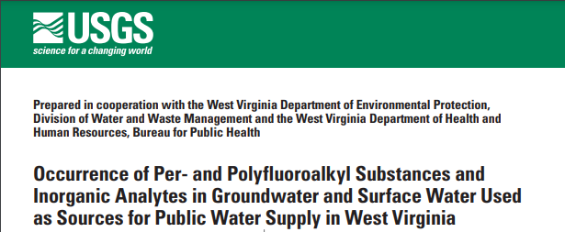
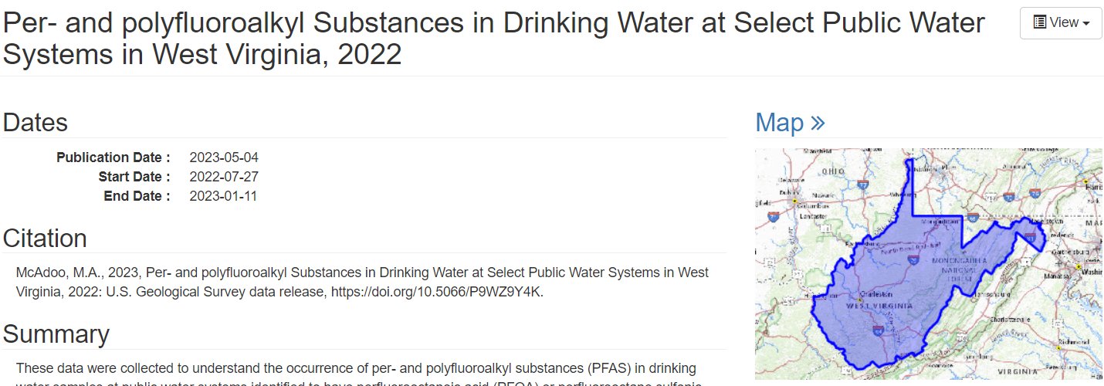
PFAS in Raw & Finished Drinking Water in WV
279 water systems tested (raw)
37 water systems above reporting levels (raw)
19 water systems exceeded MCLs (finished)
Notes:
When did the USGS source water study come out? -> XXX 2022
Source water tested for 279 water systems
130 water systems exceeding EPA’s health advisories for PFOA and/or PFOS
Note: updated health advisories published June 2022
37 water systems had detections above the reporting level for PFOA and/or PFOS

Slide 7
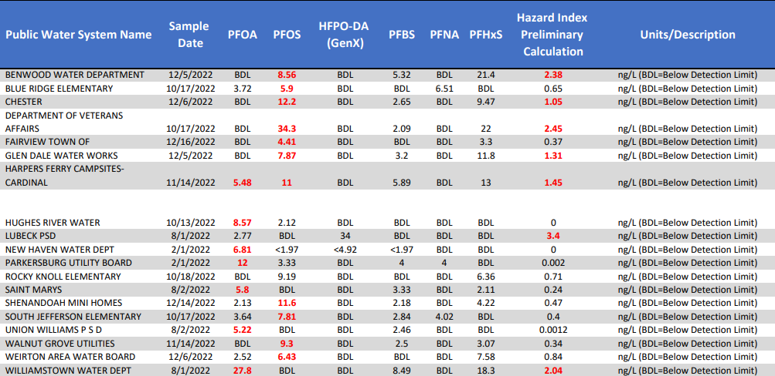
Water Systems with PFAS Exceeding Draft MCLs
Notes:
In 2020, the West Virginia Legislature passed Senate Concurrent Resolution 46 (SCR46), which required WVDEP and the WVDHHR to test for PFAS in the source water for all public water systems in West Virginia, results published in July 2022
They tested for (up to 28) PFAS at 279 public water systems, including 27 schools/daycares
In the raw water of 130 water systems, PFAS (PFOA and/or PFOS) exceeded the EPA's health advisory
These 130 community water systems serve around 700,000 West Virginians!
It is unknown whether customers of those utilities have PFAS in their finished (treated) tap water
The state is currently studying the presence of PFAS in finished water in 37 water systems
37 because the study came out before the EPA released it’s new interim health advisory
This data should be released in ??? 2023
Link to study: https://pubs.usgs.gov/sir/2022/5067/sir20225067.pdf
Link to data: https://www.sciencebase.gov/catalog/item/60db3fe9d34e596d2ba5c8f7

Slide 8
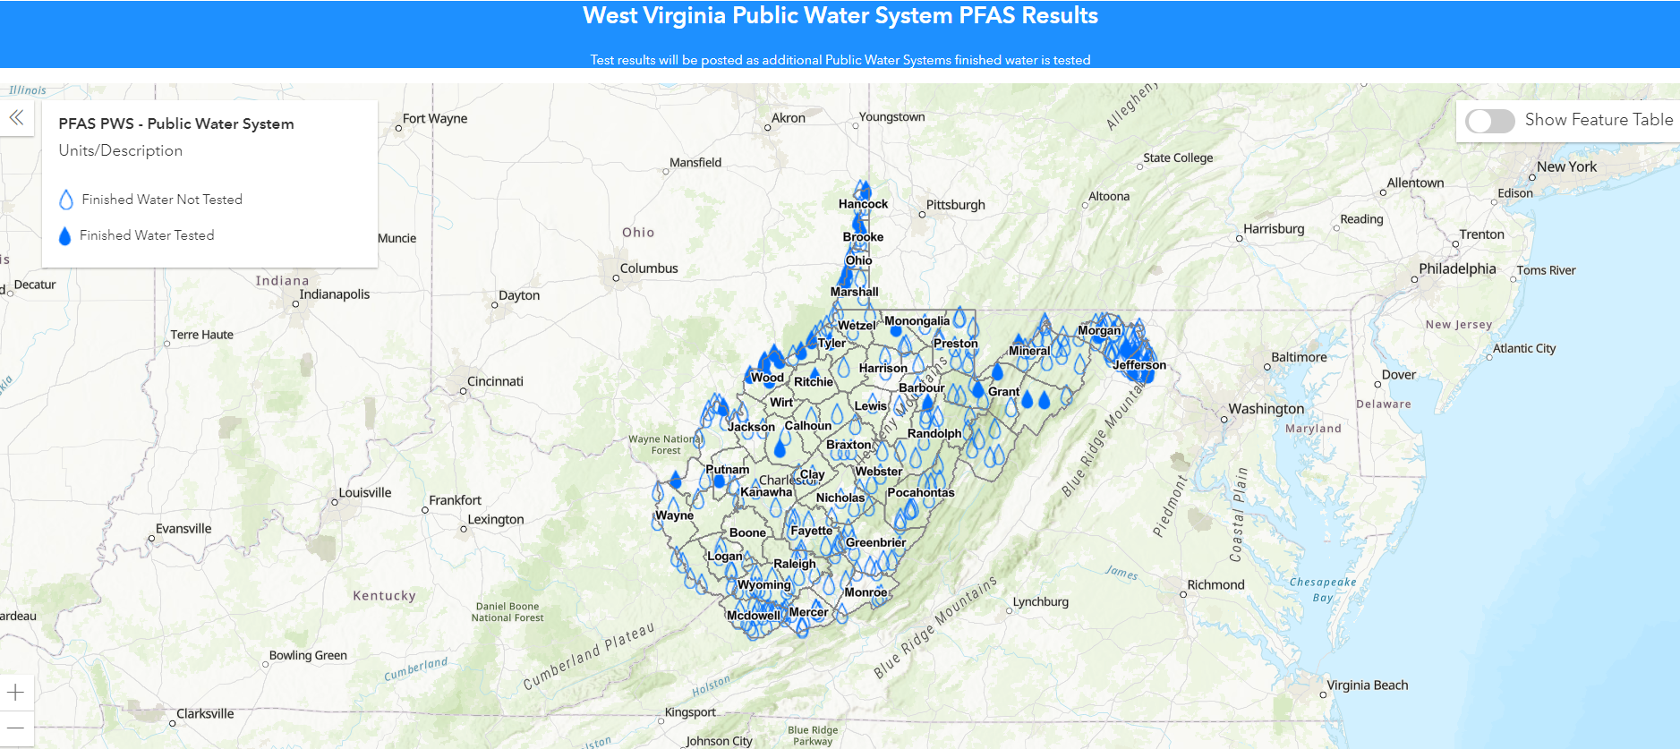
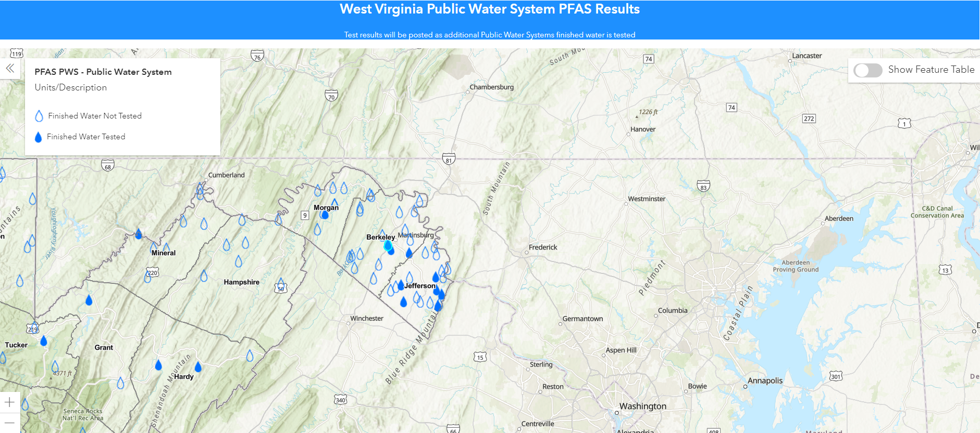
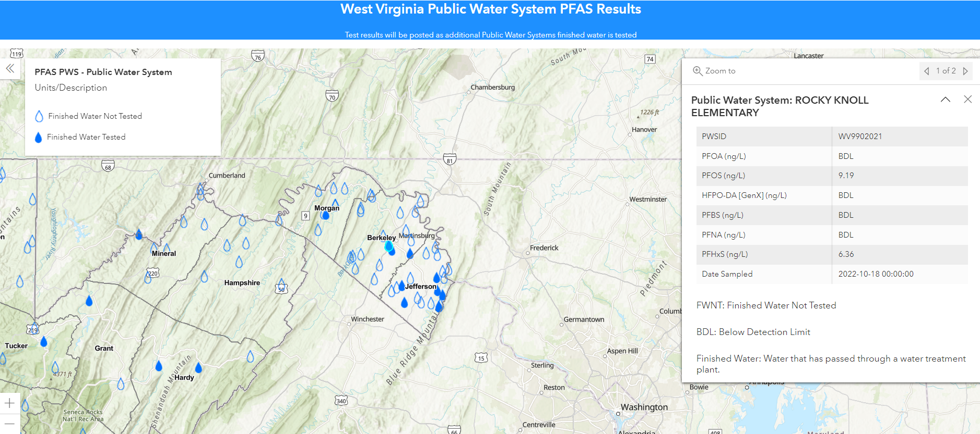
Public Water System PFAS Results Map
Notes:
Central and eastern panhandle public water systems with PFAS exceeding health advisories in raw water

Slide 9
Resources
USGS – PFAS in Drinking Water at Select Public Water Systems in West Virginia, 2022
https://www.sciencebase.gov/catalog/item/6401ff0dd34e6929881229c1
WV DHHR – Finished Water Sampling Results MCL Exceedances Table
https://oehs.wvdhhr.org/media/aotbii4w/pfas-finished-water-sampling-results_mcl-exceedances.pdf
WV DHHR – Public Water System PFAS Results Map
https://oehsportal.wvdhhr.org/pwspfas/
WV DHHR
https://oehs.wvdhhr.org/eed/source-water-assessment-wellhead-protection/
EPA’s Proposed PFAS Drinking Water Regulation Frequently Asked Questions and Answers
https://www.epa.gov/system/files/documents/2023-04/Public%20FAQs_PFAS_NPDWR_Final_4.4.23.pdf
EPA's How to Calculate the Hazard Index
https://www.epa.gov/system/files/documents/2023-03/How%20do%20I%20calculate%20the%20Hazard%20Index._3.14.23.pdf

Slide 10
Dr. Alan Ducatman
Professor emeritus West Virginia University
Notes:
Our next speaker is Dr. Alan Ducatman.
Alan Ducatman is board certified in Internal Medicine and Occupational Medicine. He is professor emeritus at West Virginia University, author of more than 40 scientific papers concerning ‘PFAS’, and a frequent participant on national and international committees tasked with health and safety decisions.

Slide 11
Alan Ducatman, MD, MS Professor emeritus, West Virginia University aducatman@hsc.wvu.edu
Washington Works, WV
Declarations:
Contributed to Design; Led Participant Health communications for “C8 Health Project” in contaminated water districts, WV and Ohio beginning 2005
COI declaration: participate as paid and unpaid consultant to communities seeking medical monitoring benefits following PFAS water contamination

Slide 12
Array of Historic Sources, Uses
Surfactants/Dispersants; Industrial manufacturing Aid in numerous commercial products :
Food packaging (including pet food). Food preparation bags. Example: microwave popcorn
Medical device (including coatings for stents), eyedrops, contacts, implantable surface coat
Home barrier insulation and specialty paints – future spray on roof applications proposed
Specialty Paper coatings – “Take out” and disposable plates/containers, pizza box,
Treatments for Fabrics and Carpets, Outdoor wear and Leather
Adhesives (including carpet backing)
Ski wax, bike lube
Electronics, solar panels, elastomeric coating for electrical cables.
Cleaners, treatments: gun cleaners, chain cleaners, engine coaters, auto detailing, piano tuning (2 uses)
Hydraulic fracturing lubricant and tracer technology
Chrome plating and photolithography
AFFFs – most prevalent source in groundwater and drinking water, may contain a complex mixture, and each batch can vary to meet a standard (“MilSpec”)
Shaving, cosmetics, flosses

Slide 13
C8 Science Panel 2005-13 (PFOA-contaminated water, N=69,030, and literature review) There are now > 1000 peer review papers concerning this chemical class, human exposures, and health effects
“Probable Link” Findings
- Hypercholesterolemia¹
- Thyroid Disease²
- Ulcerative Colitis²
- Testicular Cancer
- Kidney Cancer¹
- Pregnancy-induced Hypertension
1. Substantially Increased Evidence since 2015 2. Nuances since 2015

Slide 14
Examples of Outcomes other than probable links that have become clearer since the Science Panel Deliberated
Liver Disease
Hyperuricemia

Slide 15
California Basis for PFAS Health Goals
Notes:
We might need permission for this. From August 30 2021 Presentation of Elaine Khan And Craig Steinmaus. Cal Proposed Public Health Goals and Non Cancer Health Protective Concentrations for PFOA and PFOS in DW.

Slide 16
PFAS Outcome Examples – my View
Strong Evidence
Substantial Evidence
Some or conflicting evidence
Immunotoxicity, vaccine uptake
Lipids /Sterol interference, Associated Codeable conditions and longitudinal diagnoses and medications
Kidney cancer
Liver Functions and Steatosis
Thyroid Alterations/Binding proteins
Uric Acid - Hyperuricemia/Gout
Birthweight
Breast Feeding, diminished capability
Insulin Resistance/Diabetes
Kidney Disease
Osteoporosis
Preeclampsia/PIH
Testicular Cancer
Asthma, Allergy
Cardiovascular/BP
Childhood adiposity
Fecundity diminished (with physiology evidence for ovarian, testicular function and sperm morphology motility)
Liver cancer & Breast cancer
Infections, notably in early childhood
Thyroid disease
Developmental: Intrauterine Growth Retardation (IUGR), Preterm birth
Ulcerative Colitis

Slide 17
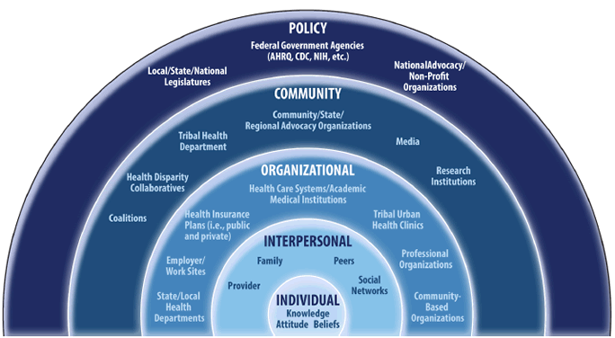
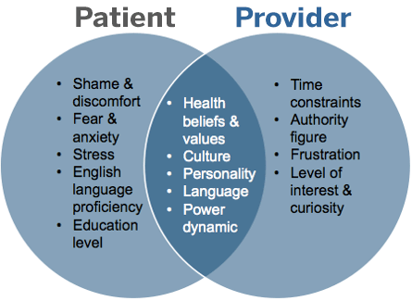
Clinician-Patient Communications About Exposures and Health AHRQ SOCIO ECOLOGICAL MODEL for Prevention CLINICAL MODEL *Others Interested (and Influencing); Water manager, well owner, insurers, health/environment agencies, …………
Notes:
This is AHRQ, so I think the graphic is public domain.

Slide 18
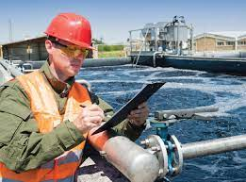
Our Most Difficult Communication Group
Water utility managers are:
Caught in the middle
Worried about another large task, and
(In)sufficient Funds to do the task and
Costs that will be passed to consumers

Slide 19
Evan Hansen
Delegate, West Virginia House of Delegates
Principal, Downstream Strategies
Notes:
Our next speaker is WV Delegate Evan Hansen.
Evan founded Downstream Strategies in 1997. For a wide range of science, policy, planning, and economic development projects, he manages interdisciplinary research teams, performs quantitative and qualitative analyses, provides litigation support, and communicates results with policymakers, local leaders, private companies, and nonprofit organizations. Elected to the West Virginia House of Delegates in 2018, Delegate Hansen serves on multiple committees including Energy & Manufacturing and Natural Resources, as well as the Joint Commission on State Water Resources.

Slide 20
Scott Mandirola
Deputy Cabinet Secretary,
West Virginia Department of
Environmental Protection (WVDEP)
Notes:
Our next speaker is Scott Mandirola, Deputy Cabinet Secretary of the West Virginia Department of Environmental Protection. Mandirola joined the WVDEP, Division of Water and Waste Management in April 2006, and was named Director of the division in 2010. While he continued to hold that position, Mandirola was appointed Deputy Cabinet Secretary of WVDEP in June 2015 and served in both roles until July 2018. He is now the Deputy Cabinet Secretary for External Affairs, as well as the Chief Science Officer. Mandirola serves as the liaison between the WVDEP and outside groups such as the state legislature, federal legislators, other West Virginia State agencies including the Department of Commerce, Environmental Council of the States, EPA, USACE and the Ohio River Valley Water Sanitation Commission (ORSANCO).

Slide 21
Questions?
We will take questions asked in the chat first.
Please raise your hand if you would like to be called on to ask your question aloud to the presenters.

Slide 22
Thank you for joining us!
Please look out for the follow up email, which will include the recording from today's meeting and any resources discussed. You can join our mailing list at wvrivers.org and any additional questions can be directed to wvrivers@wvrivers.org.

